Slide 1
Unemployment
Link (watch after explaining labor force and unemployment rate)

Slide 2
Learning Objectives Checklist
What are?
  Working Age Population
  Labor Force
  Unemployed vs Jobless
Types of Unemployment
  Structural, Frictional and Cyclical
Natural Rate of Unemployment
  Business Cycle and Unemployment
  ARU vs NRU

Slide 3



3 Crucial Economic Indicators
The three biggest economic indicators used in Macroeconomics are:
  Gross Domestic Product (how big is the economy)
  Unemployment (how many people have jobs)
  Inflation (how stable are the prices of goods and services)
Economic Indicators
Gross Domestic Product (GDP)
Unemployment
Inflation
Unit 2
3 Economic Indicators

Slide 4
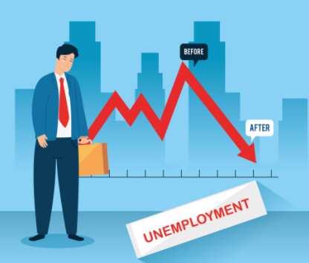
What is unemployment?
Most people have an understanding of unemployment already; when people do not have a job.
In this section we will learn a more exact definition for unemployment and terms such as:
  Working Age Population
  The Labor Force
  Official definition of unemployment
  Underemployed
  Discouraged Workers

Slide 5
The Labor Force and Working Age Population

Slide 6
The Labor Force
Summary
In the
Labor Force
Working Age
Willing and able to work
Not in prison
Not in the military
In our economy we know have people who are working and not working.
The Labor Force is the number of people who are trying to work.
It will naturally be smaller than the whole population, because not everyone is expected to work or wants to work.
Working Age Population
Whole population

Slide 7

Working Age Population
The working age population is simply the people in society who are not too young and not too old to work.
The working age population is typically defined as ages 16 – 65.
  Of course, it is not uncommon for people to work beyond the age of 65.
  People can often do informal work below the age of 16.
Note: As we will see, this does not mean that people of working age will actually work.
Summary
The working age population is people between the age of usually 15-65.

Slide 8




People who are too old or too young are usually not expected to work and so are not in the Working Age Population.
Working Age Population
Whole population
People who are not in the working age population:
Babies, children, elderly

Slide 9
Which groups are not in the working age population?
Elderly people
Children

Slide 10

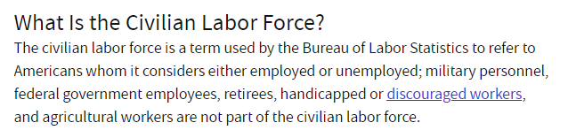
The Labor Force
Summary
Labor Force = people between 16-65 who are able to work and looking for work
The labor force includes all people who ARE or ARE TRYING to participate in work as a profession.
  Note: This means that if you don’t have a job but are at least trying to get one, you are in the labor force even if you’re not working.
Labor Force
  Old enough (usually 16+ years)
  Capable of working (eg. healthy and mentally capable)
  Actively looking for work
  Not in prison or other institutions
  Not retired
“We are all ready to work!”
Note: Different definitions of the labor force can exist that don’t include government workers etc.

Slide 11



Who is not in the Labor Force?
Labor Force
Working Age
Able to work and LOOKING for work
Not in prison
Not in the military
Many people do not fit the criteria of the labor force.
  Eg. A student who is studying instead. A retired person. Someone whose partner works.
People who are not in the labor force:
Retired, stay at home parents, students, early retirees
Working Age Population
Whole population
People who are not in the working age population:
Babies, children, elderly
Summary
Certain groups are not in the labor force.

Slide 12
Why is a 25 year old full time university student not in the labor force?
Because they are not looking for a job.

Slide 13
Labor Force Participation Rate
Labor Force
Working Age
Able to work and LOOKING for work
Not in prison
Not in the military
The labor force participation rate shows us the percentage of working age people are actually seeking work.
Labor Force Participation Rate
Working Age Population
=labor force / working age population
= people who are 16+ and seeking work / working age population
= (employed + unemployed) / Working age population
Whole population

Slide 14


Slide 15

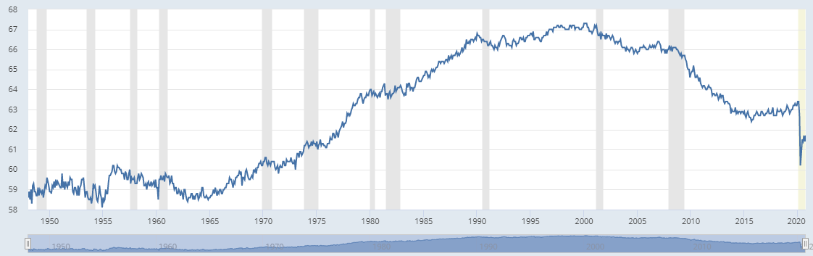
Labor Force Participation Trends
What contributed to the original rise in the labor force participation rate from the 50s and 60s?
  Female empowerment among other factors
Link: why are levels falling?
After the Economic Recession of 2009
Women entering the workforce.
COVID-19

Slide 16
What defines people in the labor force?
People who are:
  Of working age – usually between 16 and 65
  Willing – looking for a job
  Able – capable of working
Is the labor force the same as the working age population?
No, people in the labor force are working age people who are looking for a job. There are some working age people who don’t look for jobs.
How do we calculate the labor force participation rate?
LFPR = labor force / working age population.

Slide 17
Unemployment and the Labor Force

Slide 18
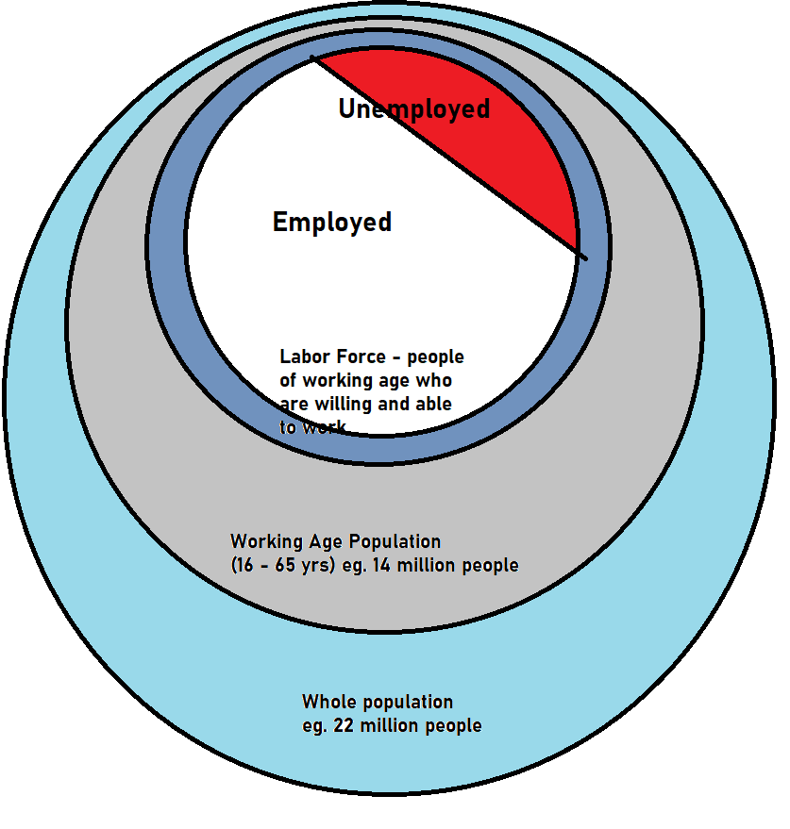
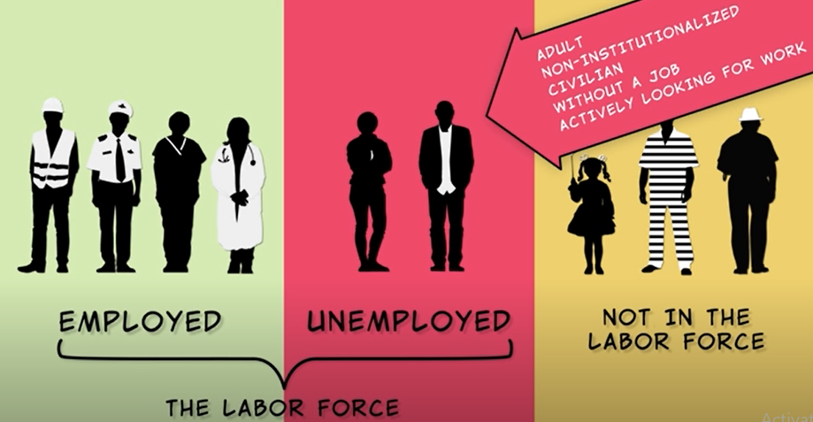
Employed, Unemployed and Labor Force
Summary
The labor force is made up of two groups of people: employed and unemployed.
Looked for but didn't find a job.
We can see that the labor force is split into those who:
  Were able to find a job
  Were not able to find a job
Looked for and found a job.
The labor force
Labor Force = employed + Unemployed

Slide 19
How do we calculate the labor force?
Labor force = unemployed + employed
This is all working age people who are able to work and are searching for a job.

Slide 20



Unemployment
Unemployed:
No job.
Working age, willing and able to work.
Looking for a job.
  (So if you’re not looking for a job, you can’t technically be unemployed)
Someone who is unemployed does not have a job.
However, the definition of unemployed in the US requires that people are searching for a job.
This actually means they must have filed an application form or gone to an interview in the last 4 weeks.
  If they have not done this in the last 4 weeks then they are technically not unemployed, just jobless.
Summary
An unemployed person is someone who is looking for a job but hasn’t successfully found one.

Slide 21


Unemployment Rate
The unemployment rate is one of these key indicators that people consider to evaluate the economy’s health.
Governments, citizens, businesses and many groups are interested in changes to the unemployment rate.
Unemployment rate = unemployed / labor force
= unemployed / (employed + unemployed)

Slide 22
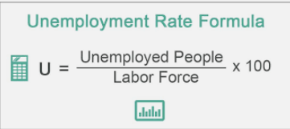

Slide 23
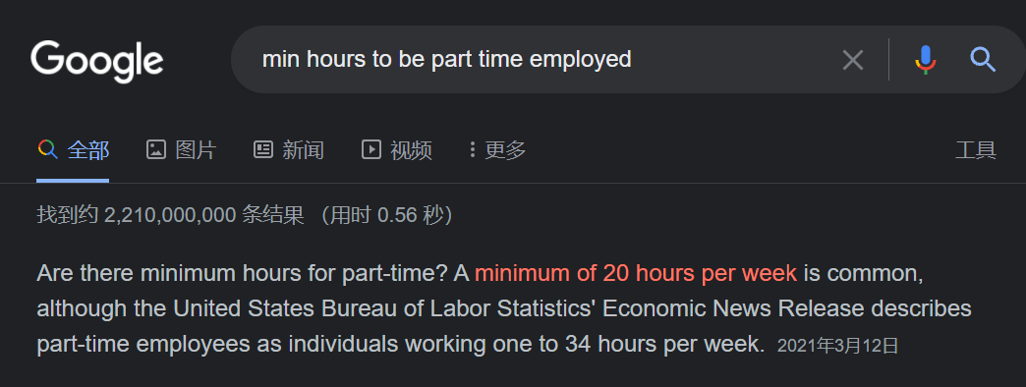
Part Time vs Full Time Work
Both part time and full time workers are considered employed.
Even though part time workers will work fewer hours, they still have a job.
Therefore they will not be counted as unemployed.
Summary
Both part time and full time workers are employed. They are not unemployed.

Slide 24
What are the 3 main things that define an unemployed person?
Able to work – working age, not in prison
No job
Actively looking for a job (has applied for a job in the past 4 weeks)
How is the unemployment rate calculated?
Unemployment rate = unemployed / labor force
              = unemployed / (employed + unemployed)

Slide 25


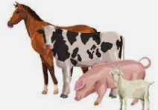

Jobless ≠ Unemployed
Summary
Jobless is not the same as Unemployed. Though all unemployed are jobless.
Just because you don’t have a job, doesn’t mean you are unemployed.
To be unemployed you have to also BE SEARCHING FOR A JOB.
Unemployed:
No job.
Working age, willing and able to work.
Looking for a job.
All unemployed people are jobless.
All cats have 4 legs.
Not all jobless people are unemployed.
BUT
BUT
Not all animals with 4 legs are cats.
Eg. People who retire early
Discouraged workers
Students
Stay at home parents
People who want to live off welfare
Wealthy retired people

Slide 26
Why are not all jobless people considered unemployed?
No, some people without jobs aren’t looking for jobs. Eg. Retired people, very rich people, housewives/husbands, students etc.

Slide 27
Unemployment Equations
Unemployment Rate = unemployed / labor force
= unemployed / (employed + unemployed)
Labor Force = employed + unemployed
Labor Force Participation Rate (LFPR) = labor force / working age population
= (employed + unemployed) / Working age population

Slide 28
Link (Unemployment)
Really explains the labor force and basics of unemployment

Slide 29
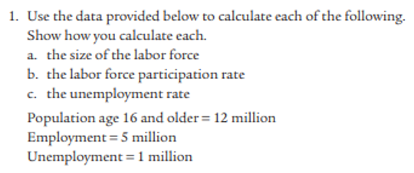
A. Labor force = all people looking for a job = employed + unemployed = 6 million
B. Labor force participation rate = 6 million / working age population = 6/12 = 50%
C. Unemployment rate = unemployed / labor force = unemployed / (employed + unemployed) = 1/(5+1) = 16.7%

Slide 30

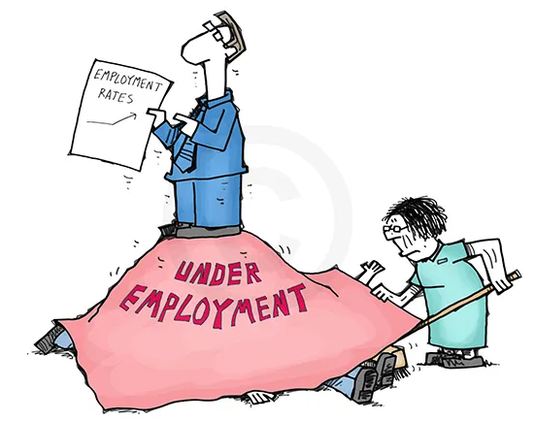


The unemployment rate doesn’t tell the whole story about problems with employment.

Slide 31




Problem with Unemployment statistic - Underemployed and Discouraged workers
Summary
Discouraged workers – given up searching
Underemployed – not enough hours or not using full skills
Neither of these count as unemployed but they are jobless/underutilized
There are two common criticisms of the unemployment rate:
Underemployed workers
They are technically employed but can’t find enough work hours. Eg. Only working part time when they want a full time job.
They may be unable to find a satisfying job that makes full use of their skills so they are underutilized.
Eg. A college graduate can only find part time work as a waiter when they want to work full time work in a field relevant to their qualification.
Discouraged workers
Members of the work force may become tired of not finding employment and may give up the search.
They are technically no longer unemployed because they have to be actively seeking work in the last 4 weeks*
Both of these factors contribute to the rate of dissatisfaction and are therefore a problem! However, neither of these things are measured in the unemployment rate.

Slide 32


Slide 33

What is the difference between underemployed and unemployed?
Underemployed workers – have jobs but want to work more or in better jobs
  Eg. A Ph.D. holder who works a very low skilled job.
  Eg. A worker who wants to work 40 hours a week but their job will only give them 20 hrs a week.
What is a discouraged worker?
Discouraged workers – have left the labor force because they have given up looking for a job.

Slide 34
Unemployment Equations
Unemployment Rate = unemployed / labor force
= unemployed / (employed + unemployed)
Labor Force = employed + unemployed
Labor Force Participation Rate (LFPR) = labor force / working age population
= (employed + unemployed) / Working age population
Unemployment Rate with MORE discouraged workers
= (Unemployed – X) / (Labor force – X)
↓UR because top decreases by larger proportion than bottom
Unemployment Rate with LESS discouraged workers who don’t find jobs
= (Unemployed + X) / (Labor force + X)
↑UR because top increases by larger proportion than bottom

Slide 35

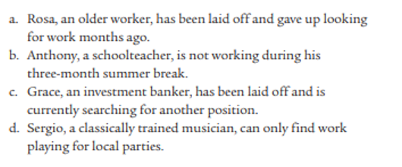
Module 12 - Krugman
A) not unemployed. Discouraged.
B. Employed.
C. Unemployed – because she’s looking for a job.
D. Employed but underemployed.

Slide 36
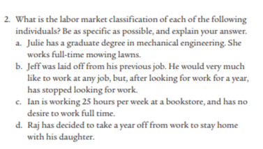
Module 12 Krugman
Employed but underemployed.
discouraged worker. (but not unemployed)
Employed – no problems.
Not unemployed because he isn’t looking for a job.

Slide 37
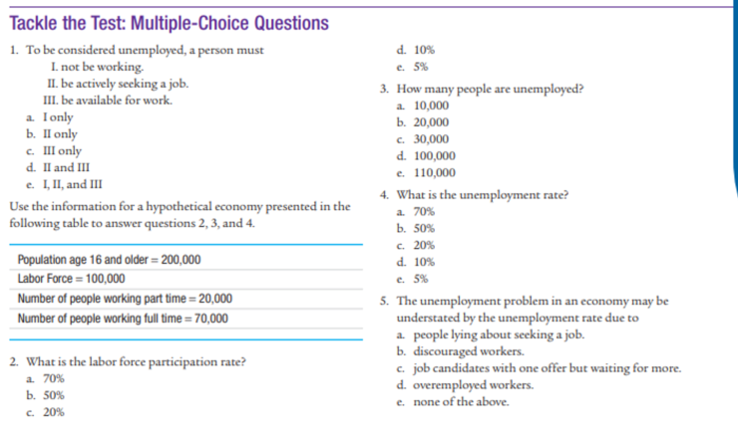
Module 12 Krugman
Answer: E
Answer: A
100 – 20 – 70 = 10
Answer: D
10/100 = 10%
Answer: B
Answer: B
100/200 = 50%

Slide 38
Total Adult Population | 2000
Full time workers | 900
Part time workers | 140
Unemployed | 90
Discouraged Workers | 30
Number of workers in labor force
Labor force = 900 + 140 + 90 = 1130
Labor force participation rate
= labor force / working age population = 1130 / 2000 x 100% = 56.5%
Unemployment rate (show working)
= unemployed / labor force = 90 / 1130 x 100% = 7.96%
Assume that 30 of the unemployed now become discouraged workers. What is the new unemployment rate?
(90-30) / (1130 – 30) x 100% = 5.45%
What is misleading about the new unemployment rate?
It is lower than before, which seems like a good thing, even though the discouraged workers are a negative thing for the economy.

Slide 39

Types of Unemployment

Slide 40

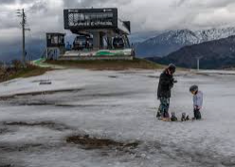
Types of Unemployment
Frictional – people moving between jobs. This unavoidable and not a particularly negative thing because it is not considered long term.
Structural – there is a long term imbalance between people’s skills and the jobs available. Either firms can’t find the right people or people can’t find the right jobs. Eg. A factory closes down in a town and many people lose their jobs. Link
Note: Some people argue that the minimum wage (a form of price control), contributes to structural unemployment.
Technological – could be classed as a type of structural unemployment. Involves the loss of jobs due to technology. Eg. Bank tellers replaced by ATMs and Electronic Funds Transfer.
Seasonal – Eg. A ski instructor only works in winter. An ice cream vendor only sells in summer.
Cyclical – when the economy slows down there are less job opportunities. Eg. The present COVID induced recession. Link
The opposite is also true for when the economy enters a prosperity phase; there will be more jobs.
Link

Slide 41


Frictional Unemployment
Home
Job 1
Frictional unemployment is also referred to as search unemployment and wait unemployment.
Some of the individuals who are not working may be in a transitional stage between two jobs. For example, an individual may be waiting to join a new job where he/she has been hired or relocated.
This type of unemployment is inevitable, since at any point in time, some individuals might be changing their jobs and it is virtually impossible to not have a few days or weeks before you start the new job.
These individuals have a great chance of finding a job and so it is not serious.
Eg. 2 weeks in between
= frictional unemployment
Job 2

Slide 42
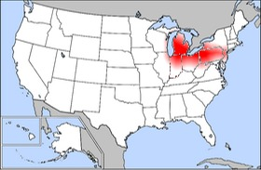
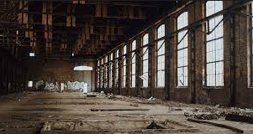

Structural Unemployment
Home
Structural unemployment occurs due to a mismatch between the jobs and the workers. This means that the available workers will be incompatible with the structure of the job.
Government training programs can sometimes help workers to get the skills they need and find jos.
Some Causes:
Decline of certain industries.
  For example, many manufacturing jobs in developed countries have been moved to countries with lower wages. This has caused some amount of structural unemployment in these countries. Eg. US cloth making jobs.
Technology.
  For example, certain jobs might become obsolete due to technological advances. Eg. Many bank workers were replaced with ATM machines. Many drivers in the future will be replaced by self driving cars.
An abandoned factory in the ‘rust belt’ of the US, where many manufacturing jobs have disappeared.
Some jobs have already been replaced by technology and this trend will only increase with advanced robotics and AI.

Slide 43
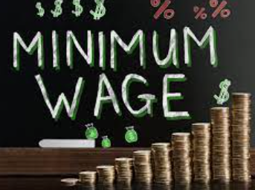

More Structural Unemployment Causes
Minimum Wage
Minimum wage pushes up the price of labor which can cause businesses to hire less workers, contributing to structural unemployment.
Trade Unions/Collective Bargaining
Workers can sometimes form groups to ask for better conditions and higher wages. This also makes businesses less willing to hire.
This can also contribute to structural unemployment.

Slide 44
Seasonal Unemployment
Home
Seasonal unemployment results from the change in demand due to seasonal factors.
The demand for specific products, such as ski equipment, ice-cream, winter jackets, hotel rooms, varies according to seasons.
More or less people will be hired depending on the time of year.
As the ice melts and summer arrives, what will happen to the number of people employed as ski instructors as well hotel workers near the ski slopes etc.

Slide 45
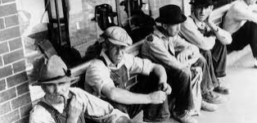

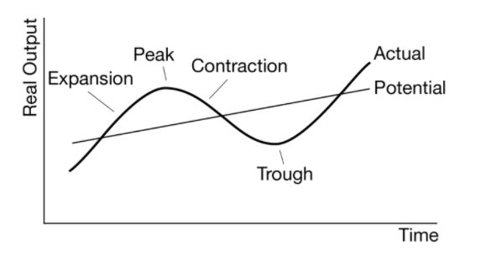
Cyclical Unemployment – The Business Cycle and Unemployment
Home
Cyclical unemployment is unemployment connected to the business cycle.
  Increases in periods of economic contraction
  Decreases in period of economic expansion
Unemployment during the Great Depression spiked to record levels.
Unemployment decreases
(more jobs)
Unemployment Increases
(less jobs)
Unemployment decreases
(more jobs)

Slide 46
What are three types of unemployment? Explain each briefly.
Cyclical – the economy is in a recession and there are less jobs available.
Frictional – workers are moving between jobs and will not be unemployed for long.
Structural – there is a long term discrepancy between skills and the jobs available. Eg. someone has truck driving skills but there are no truck driving jobs available

Slide 48

Effect A: Reduce frictional unemployment. (eg. You change job and are able to find a job in 2 weeks versus 3 weeks so you are unemployed for less time.)
Effect B: Discouraged workers start looking for work again. This will actually increase unemployment rate because they are now looking for a job and haven’t found one (yet). (This is why the unemployment rate can sometimes be misleading)

Slide 49
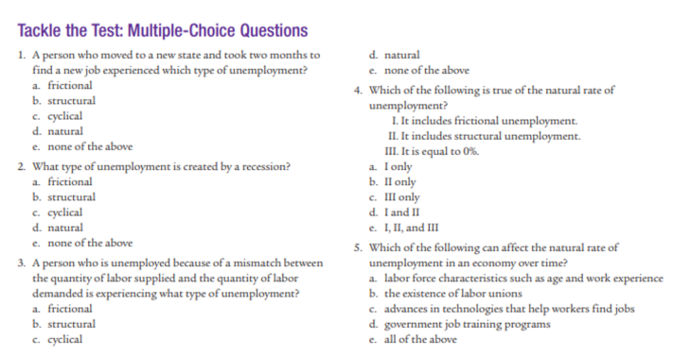

Krugman Module 13
Answer: a
Answer: c
Answer: b

Slide 50
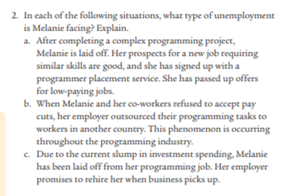
Krugman Module 13
A. frictional – temporary
B) Structural – long term
C) Cyclical – related to business cycle

Slide 51
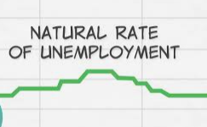
The Natural Rate of Unemployment
Link
Summary
NRU = level of unemployment without cyclical unemployment = structural + frictional
In short, this is the default level of unemployment! This is the level when the economy is at a good and healthy level.
A certain amount of unemployment is inevitable even when the economy is healthy. This level is the natural rate of employment.
We also often call this ‘full employment’
Natural unemployment = Frictional unemployment + Structural unemployment
Natural unemployment rate = Frictional unemployment rate + Structural unemployment rate
It is calculated this way because even when there are no ‘problems’ with the economy, these two types of unemployment are unavoidable.
The Natural Unemployment Level is also referred to as Full Employment!
Neither of these mean 100% of people have jobs!
NRU = Full Employment

Slide 52
What two types of unemployment make up the natural unemployment rate? (These are two types of unemployment that are impossible to avoid entirely, even if the economy is healthy.)
Natural unemployment rate = structural + frictional unemployment
Is the NRU = 0?
No, we will always have some frictional and structural unemployment.
What is full employment? Is it equal to 100% employment?
Full employment is the same level as when we have the natural rate of unemployment.
It is not equal to 100% employment!

Slide 53
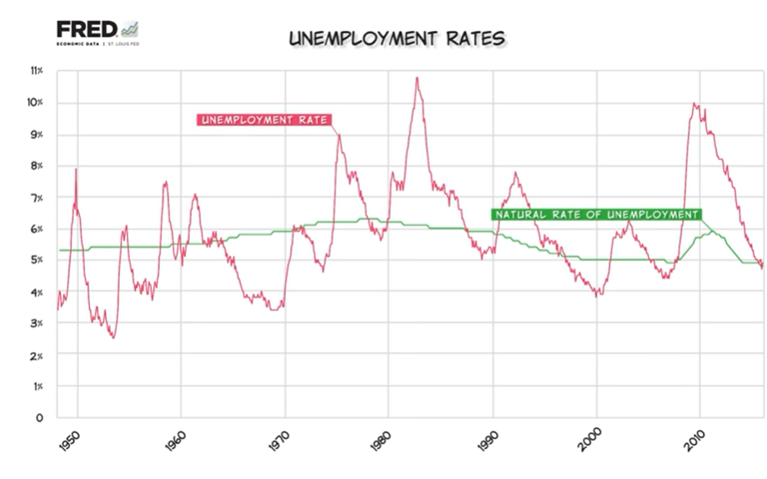
Actual Unemployment = Natural Rate of Unemployment + Cyclical Unemployment Rate
Frictional + Structural

Slide 54
Is the actual rate of unemployment always equal to the natural rate of unemployment?
No, the ARU is often above or below the NRU.

Slide 55



Actual Unemployment, NRU and Cyclical Unemployment
Summary
We can observe the relation between Actual UR, NRU and cyclical UR.
ARU = NRU + Cyclical
Actual Rate of Unemployment = Natural Rate of Unemployment + Cyclical Unemployment Rate
ARU = NRU + Cyclical Unemployment
Economic Contraction:
  Cyclical Unemployment > 0
  Therefore: Actual Unemployment > Natural Rate of Unemployment
Neither expansion or contraction:
  Cyclical Unemployment = 0
  Therefore: Actual Unemployment = Natural Rate of Unemployment
Economic Expansion:
  Cyclical Unemployment < 0
  Therefore: Actual Unemployment < Natural Rate of Unemployment

Slide 56
What is the formula for the Actual UR?
ARU = NRU + Cyclical UR
What causes the difference between the actual UR and the NRU?
The difference is cyclical unemployment.
We can see this in the equation: Actual UR = NRU + cyclical UR
When the economy is in a period of high activity, what will be the relationship between ARU and NRU?
ARU < NRU

Slide 57
Business Cycle, Output and Unemployment
Summary
The Actual UR can be = > < the NRU depending on the amount of cyclical unemployment.
Because of cyclical unemployment, the Actual UR can be equal to, above or below the NRU.
Actual Output = Potential Output
Actual UR = NRU
Actual UR = NRU + cyclical UR
Actual UR = NRU + 0
When the economy is at a healthy level, there is no extra cyclical unemployment.
Actual Output < Potential Output
Actual UR > NRU
During a period of low output,
Actual UR = NRU + cyclical UR
Eg. Actual UR = NRU + 2
Actual UR > NRU eg. Actual UR = 4% + 2% = 6%
Actual Output > Potential Output
Actual UR < NRU
During a period of higher output,
Actual UR = NRU + cyclical UR
Eg. Actual UR = 4% + -2% = 2%
the actual unemployment < NRU
Note: cyclical unemployment is actually negative during an expansion!
Actual Unemployment = Frictional + Structural + Cyclical Unemployment
Actual Unemployment = Natural Rate of Unemployment + Cyclical Unemployment
The amount that we actually see
The unemployment we cannot avoid
The amount that is caused by the business cycle. (Note: it can be negative)

Slide 58
When the economy produces above potential output, is the actual UR above or below the NRU?
Higher output = more jobs = lower unemployment
Therefore Actual UR < NRU
(Cyclical UR < 0)
When the economy has lower output, what is the ARU compared to the NRU?
It will be higher because there is cyclical unemployment.

Slide 59
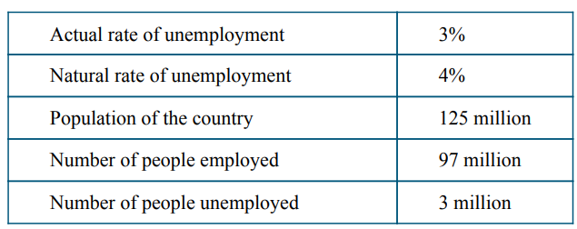
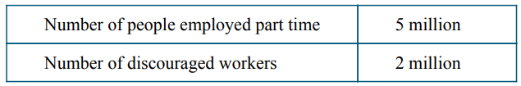
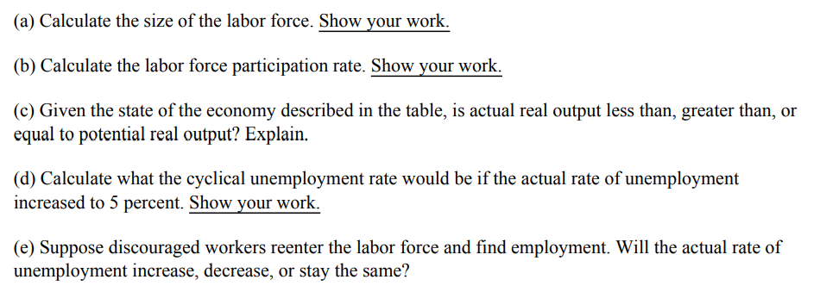
Answer Part c) and d)
C) The actual rate of unemployment is below the NRU. 3%<4%. So we are producing more than usual. Therefore actual real output is more than potential real output.
D) Actual UR = NRU + cyclical.
So cyclical would equal 1%.

Slide 60

Factors that Change the Natural Rate of Unemployment
Summary
Factors that affect the structural or frictional employment will also change the NRU.
Factors that will change the amount of structural or frictional unemployment will naturally change the Natural Rate of Unemployment!
Natural unemployment = Frictional unemployment + Structural unemployment
Changes to the labor force
  Eg. Many student graduates entering the work force may actually increase the structural unemployment.
Social Welfare – improved welfare may decrease the motivation for workers to find jobs quickly (increasing frictional unemployment)
Trade Union power (similar effect as minimum wage laws increasing structural unemployment)
Minimum Wage Laws (increasing structural unemployment because businesses will hire less workers)
Government training programs could reduce structural unemployment.
Government Training Programs – increasing worker skills could decrease structural unemployment

Slide 61
A government training program that helps workers gain new skills and find jobs would have what effect on the NRU?
The gov training would likely decrease structural unemployment which would therefore decrease the NRU.
Generous social transfers to unemployed workers leads to workers taking longer to apply for new jobs. What effect would this have on the NRU?
This would likely increase frictional unemployment which would increase the NRU.

Slide 62
Krugman Module 13
Answer: a
Answer: d
Answer: c
Answer: e
Answer: b

Slide 63
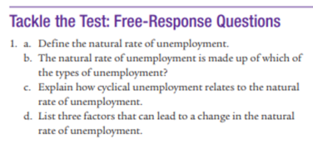
Krugman Module 13
A) it is where the economy is at a healthy level. It can also be called full employment
B) NRU = structural unemployment + frictional unemployment
C) It is the difference between the natural rate (NRU) and actual unemployment.
D) Minimum wage
Government training programs
Social Welfare
Labor force characteristics (eg. Lots of new graduates looking for jobs)

Slide 64
Unemployment Equations
Unemployment Rate = (unemployed / labor force) x 100%
= [unemployed / (employed + unemployed)] x 100%
Labor Force = employed + unemployed
Labor Force Participation Rate (LFPR) = (labor force / working age population) x 100%
= [(employed + unemployed) / Working age population] x 100%
Unemployment Rate with unemployed who become discouraged workers
= (Unemployed – X) / (Labor force – X)
Natural unemployment rate = Frictional unemployment rate + Structural unemployment rate
= [(Frictionally unemployed + structurally unemployed) / labor force] x 100%
IT IS NOT EQUAL TO ZERO
Actual Unemployment Rate = Frictional UR + Structural UR + Cyclical Unemployment Rate
Actual Unemployment = Natural Rate of Unemployment + Cyclical Unemployment
ARU = NRU + Cyclical Unemployment

Slide 65
Business Cycle, Output and Unemployment
Summary
The Actual UR can be = > < the NRU depending on the amount of cyclical unemployment.
Actual Output > Potential Output
Actual UR < NRU
Cyclical Unemployment < 0
Actual Output = Potential Output
Actual UR = NRU
Cyclical Unemployment = 0
Actual Output < Potential Output
Actual UR > NRU
Cyclical Unemployment > 0
Actual Unemployment Rate = Frictional UR + Structural UR + Cyclical Unemployment UR
Actual Unemployment = Natural Rate of Unemployment + Cyclical Unemployment Rate
The amount that we actually see
The unemployment we cannot avoid
The amount that is caused by the business cycle. (Note: it can be negative)

Slide 66
3 Crucial Economic Indicators
The three biggest economic indicators used in Macroeconomics are:
  Gross Domestic Product (how big is the economy)
  Unemployment (how many people have jobs)
  Inflation (how stable are the prices of goods and services)
Economic Indicators
Gross Domestic Product (GDP)
Unemployment
Inflation
Unit 2
3 Economic Indicators

Slide 67
Inflation

Slide 68
Class Checklist
What is inflation?
Costs of Inflation
Methods of measuring inflation:
  Consumer Price Index (CPI)
  GDP Deflator

Slide 69
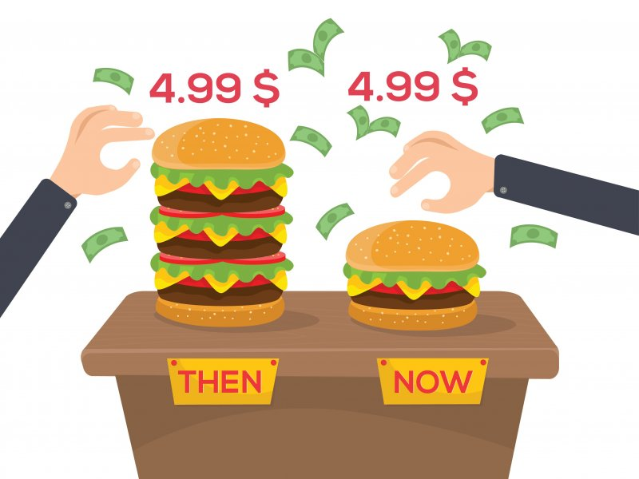

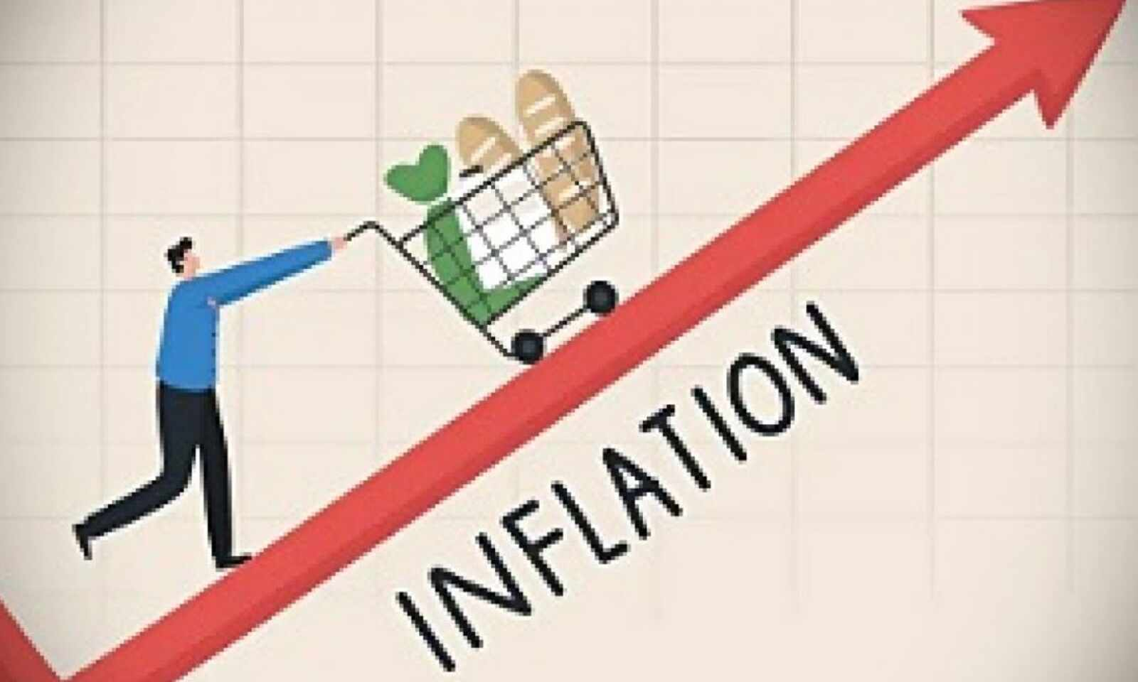
Inflation
Summary
Inflation is an increase in the price level.
What is Price Level?
Price level refers to the average price across many goods and services in the economy. We will soon see the methods we can use to measure this price level.
Definition: Inflation is a persistent increase in the price level in the economy. (Price level is the price of all the goods and services in the economy)

Slide 70
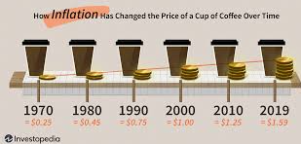

Slide 71
What is the definition of inflation?
An increase in the price level.
How do we define the price level?
It looks at the average price of a wide range of goods and services.

Slide 72


Prices in the Past through Movies and TV Shows
Most economies have inflation year on year which over a long time leads to a big price increases.
However, we will soon understand that this does not mean people were richer.
"10 Cheapest New Cars for 2020 - Car and Driver Oct 9, 2019 — 2019 Honda Fit — $17,120. Honda. 2019 Toyota Yaris Sedan — $16,405. 2019 Toyota Yaris Sedan — $16,405. 2020 Kia Rio Sedan — $16,675. 2020 Kia Rio Sedan — $16,675. 2019 Chevrolet Sonic Sedan — $16,295. 2019 Chevrolet Sonic Sedan — $16,295."
"In 1970 the average new car cost around 3,542 dollars, and a gallon of gas went for 36 cents. During the 70s many Super cars were designed from a variety of motor companies."
1970
2020

Slide 73



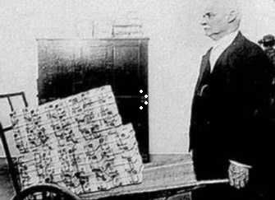


Inflation and Purchasing Power/Value of Money
Effect of inflation on wages
What happens to your money when things are more expensive?
  Your money can buy less things and so the value of money decreases.
  We can also say that the purchasing power decreases.
  Hyper-inflation – a huge rise in price level
    Usually only occurs in countries with flawed economic management
    Money can become almost worthless.
 | Price Level | Value of Money
Inflation | Increases | Decreases
Deflation | Decreases | Increases
Inflation
When the price level in the economy goes up.
Money is now worth less.
Purchasing power of money is less.

Slide 74
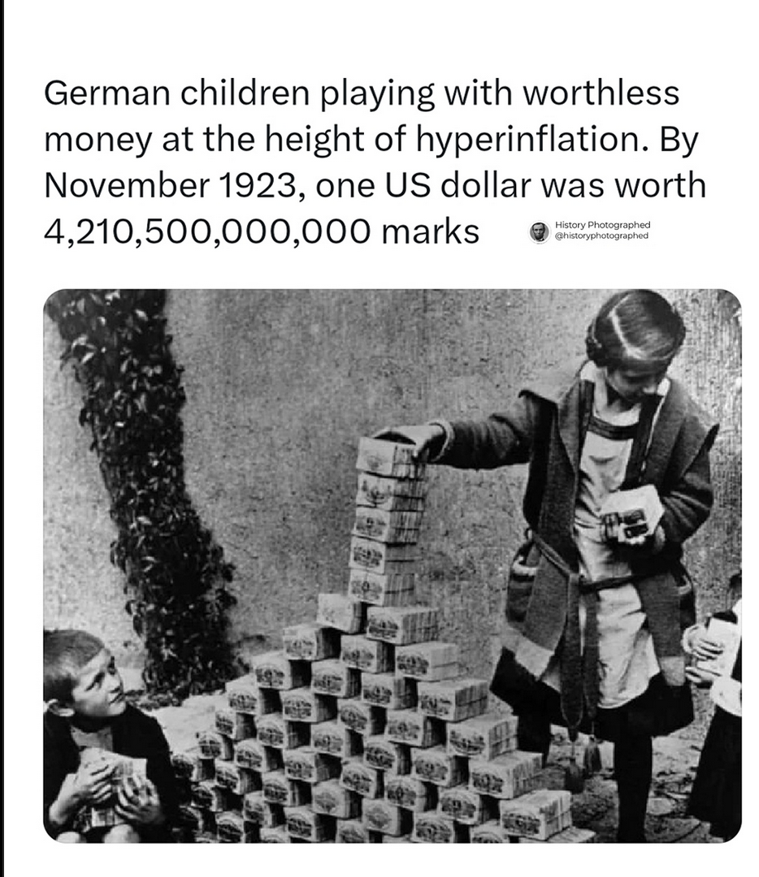

Slide 75
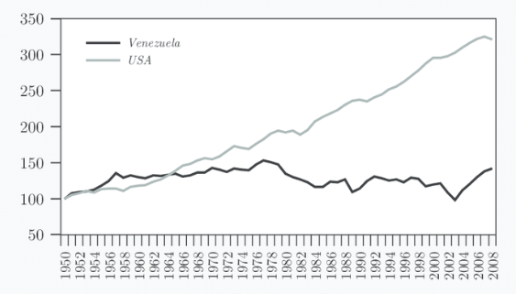
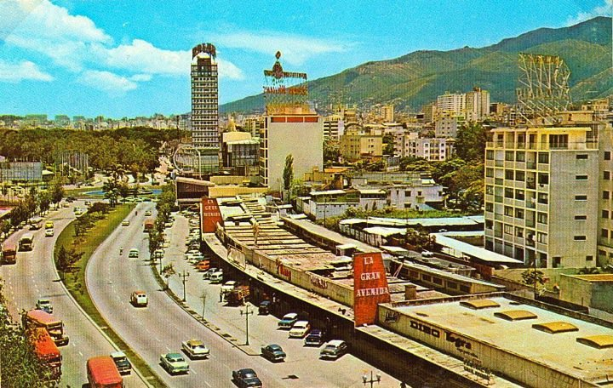
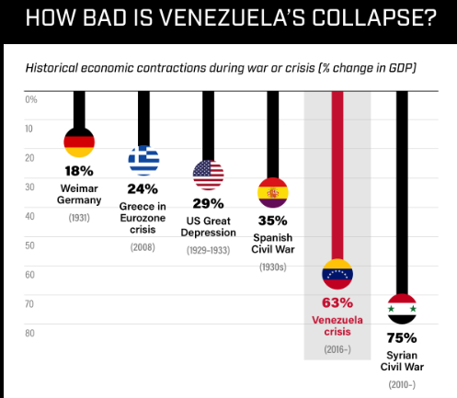
Venezuela’s Problems
Venezuela’s GDP per capita was once greater than the USA!
Venezuela’s bolivar, from banknote to children’s toy | AFP (youtube.com)
Venezuela’s capital, Caracas, in the 1960s.
In recent years, there have been many financial problems including hyperinflation.

Slide 76
What happens to prices when there is inflation?
Prices go up
What happens to the value of money when there is inflation?
Value of money goes down ie. Purchasing power goes down

Slide 77


Price Level vs Inflation
Summary
Price level – will not affect economic decisions
Inflation – acceleration of the price level, it does matter as economic decisions will change.
Inflation is the CHANGE in price level.
Price Level
The price level itself doesn’t make a difference because if the price level is high, the amount of money people have will also be high and so economic decisions will be unchanged.
Rapid Acceleration of Price Level
However, the acceleration of the price level (inflation) is important as we will soon see and has many negative consequences.
$100
$10
Doesn’t matter
$10,000
$1000
In both cases you can still buy 10 pieces of candy.
$10,000
$5000
If prices change too suddenly to $5000, faster than the salary, then we can only buy 2 pieces of candy! Our situation has changed in a very real way.
DOES matter

Slide 78
If overnight everybody has 100 times the amount of money, but prices are also 100 times higher, has anything changed in the economy?
No, not at all, though we would have to do more arithmetic.
While the number is different, people will still make the same decisions because the prices and amount of money is the same.
What situation will have a real effect on our economy?
If the prices go up quickly but the amount of money hasn’t changed.
Price level doesn’t matter, but change of price level does!

Slide 79
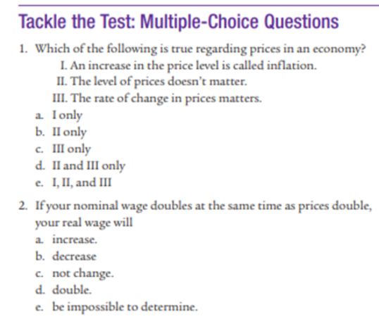

Answer: E

Slide 80
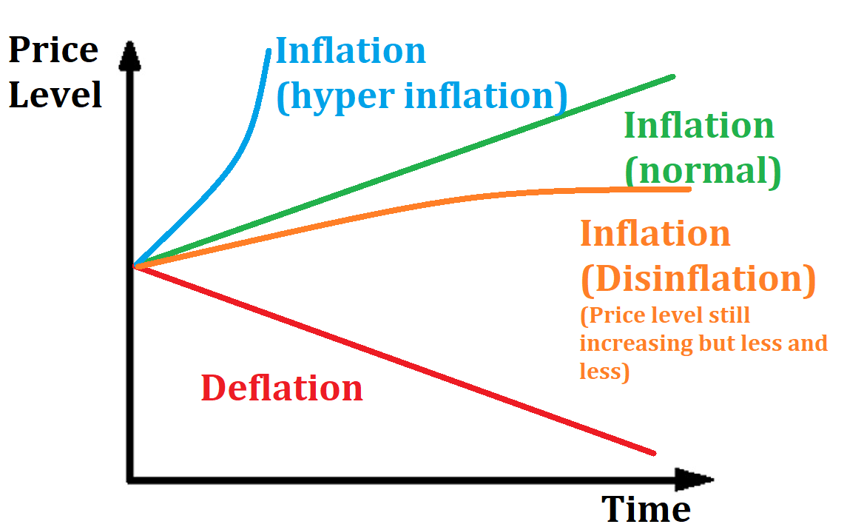
Inflation Related Terms
Inflation = rise in price level
  Hyper-inflation – a huge rise in price level
    Usually only occurs in poor countries with flawed economic management
    Money can also become worthless.
  Disinflation = rise in price level but at a slower rate eg. 4% inflation to 2% inflation
    The price level is still increasing!
Deflation = fall in price level

Slide 81
Inflation, Acceleration & Disinflation
In physics we have the term acceleration which means when velocity is increasing.
Inflation is a similar idea.
Disinflation is like a car that is still increasing in speed but the increase is getting slower and slower.

Slide 82
If prices increase 5% one year and 3% the next year, what terms can we use to describe this?
Inflation/Disinflation
If prices increase by 1000% each year, what terms can we sue to describe this?
Inflation/Hyper Inflation
If prices decrease, what term can we use to describe this?
Deflation
If we have disinflation, is this an example of inflation or deflation?
Inflation, because inflation is any situation where prices increase.

Slide 83
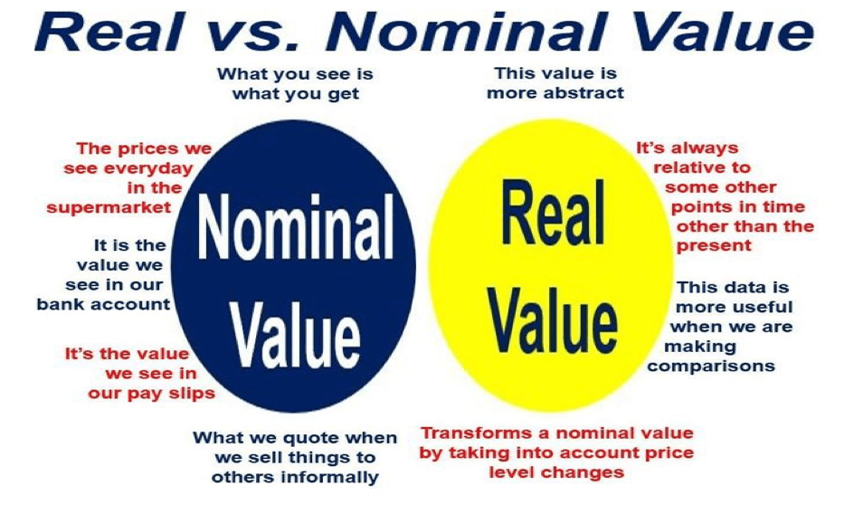
Nominal vs Real Values
Summary
Nominal wage – the numerical value
Real wage – how much you can actually buy
Inflation will decrease the real value of people’s wages.
We will often see these terms ‘nominal’ and ‘real’.
Expressed simply:
  Nominal = the numerical value
  Real = the true value
This is relevant to many things including GDP and wages.
What do we mean by the ‘true value’?
  Simply put, it means that the real value accounts for inflation but the nominal value does not.

Slide 84
Nominal vs Real Wages Example
Summary
Real wage will account for inflation and so is more important than nominal wage.
Wages - Real vs Nominal - Example
Your nominal wage increases by 50% but the price of goods and services has doubled (increased by 100%)
Should you still be happy about your wage increase?
No. Why? Because the price of G&S has increased you can afford less than before.
Your nominal wage has increased but your real wage has decreased.
Price Level
Eg. $100 –> $200
Nominal Wage
Eg. 10K –> 15K
Real Wage
You can buy less goods.

Slide 85
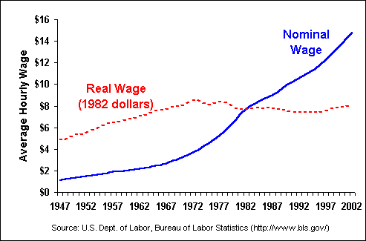
Even if the amount we earn ie. the nominal wage increases, our real wage may not increase if everything we buy is now more expensive.

Slide 86
Which of the following shows an increase in the real wage?
A: Nominal wage increases by 30%, price level increases by 40%
B: Nominal wage increases by 20%, price level increases by 20%
C: Nominal wage increases by 15%, price level increases by 5%
Answer: C, because you have more money and prices have increased by less than your increase in wage.
Which is more important, the nominal wage or real wage?
Real Wage

Slide 87
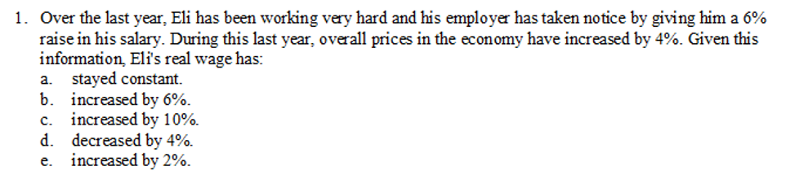
E: 6% increase in salary - 4% increase in prices = 2%
Note: this is an approximation only

Slide 88


GDP – Real vs Nominal Example
Summary
Nominal and real values can be very different and are related to inflation.
The real values are most important.
A very small economy produces 5 cars and 5 computers in 2021.
They produce the same amount in 2022. In 2022 the price of cars and computers both double compared to the previous year.
The cars and computers are the same type and quality in both years.
What happens to the nominal GDP?
It would double! Because GDP is measured in monetary terms. (Note: Nominal GDP = quantity x price of all goods produced)
What happens to the real GDP?
The actual production is the same! Same cars and computers are produced. Therefore REAL GDP is unchanged.
Note: We will soon see how we mathematically deal with nominal and real GDP.
5 x
5 x

Slide 89
If our nominal GDP increases, does this always mean that we produced more G&S in the last year?
No, we could produce the same amount or even less, but if the prices have increased a lot, then nominal GDP will increase.
Which one will give us a true representation of economic growth, nominal GDP or real GDP?
Real GDP
Real GDP will control for the effect of inflation and show us increases in production only.

Slide 90
Answer: E
Answer: C

Slide 91
Class Checklist
What is inflation?
Costs of Inflation
Methods of measuring inflation:
  Consumer Price Index (CPI)
  GDP Deflator

Slide 92
Bonus: Causes of Inflation
We will come back to the topic of inflation in Unit 3 and 5!
If you want some extra reading then feel free to try look at this.
Three causes of Inflation
  1. Demand Pull
  2. Cost Push
  3. Money Supply (Quantity Theory of Money)

Slide 93
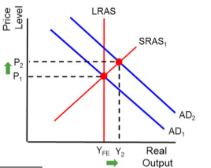
Demand Pull Inflation
We can explain both demand pull and cost push inflation using the AD/AS model. With an increase in AD caused by an increase in any of the components of AD (C+I+G+X-M), the equilibrium price level will be higher.
Eg. Prices in large cities are higher because people are more motivated to move there and will consume and invest at a higher rate.

Slide 94
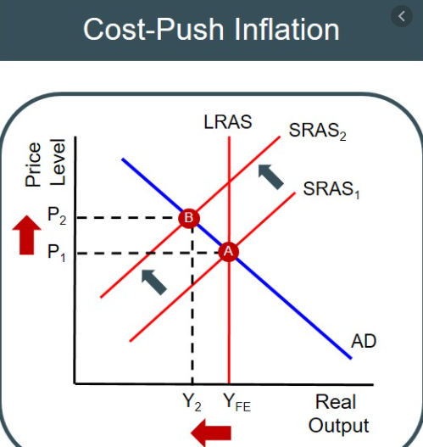
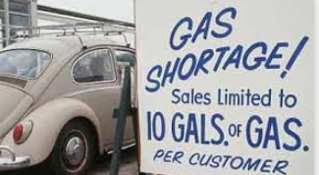
Cost Push Inflation
A decrease in aggregate supply (Eg. Increased resource costs and supply costs)
This causes lower output and higher prices! This is also called stagflation = stagnation (no growth) + inflation
Eg.1970s US stagflation
In the 1970s the OPEC countries, for political reasons, reduced their oil supply to many countries including the United States. Because oil is such an important resource, it affected the supply of many businesses. This caused the SRAS (or arguably the LRAS) to shift to the left, causing an increase in the price level.

Slide 95
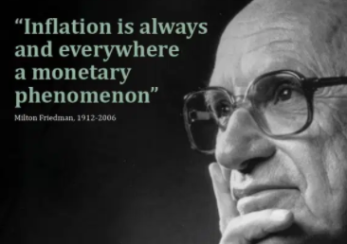
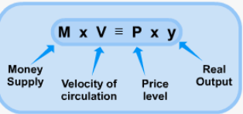

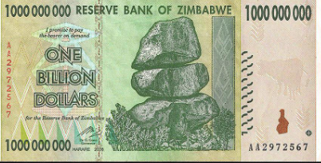
Increase in the Money Supply
(Inflation is always caused by money supply.)
According to some economists (Monetarism), the leading cause of inflation is always increases in the money supply.
This is effect is particularly apparent in poorly managed countries such as Zimbabwe and Venezuela where government money printing (creating new money) has lead to hyperinflation.
  Inflation was so bad in Zimbabwe that the US dollar was temporarily adopted as the nation’s currency because its currency became worthless.
The quantity theory of money assumes that Price Level and Velocity of money are relatively stable and that increases of money supply M will inevitably lead to increases in Price Level P.
We will cover this topic in more depth in future classes.

Slide 96
Causes of Inflation Review Question
What are three causes of inflation? Use graphs to show the effect
Demand Pull, Cost Push, Increase in Money Supply

Slide 97
Class Checklist
What is inflation?
Causes of inflation
Methods of measuring inflation:
  Consumer Price Index (CPI)
  GDP Deflator
Costs of Inflation

Slide 98
Consequences of Inflation

Slide 99








Consequences of Inflation Overview
Business and Transaction costs ___
  Menu Costs
  Shoe Leather Costs
Redistribution of wealth ___
  Value of money savings falls
  Fixed Income individuals lose (eg. pensioners)
  Borrowers gain at the expense of lenders
Inefficient allocation of resources and Confusion ___
  Inflation distorts prices which makes business decision and everyday decisions more difficult
Consequences of Inflation Home

Slide 100
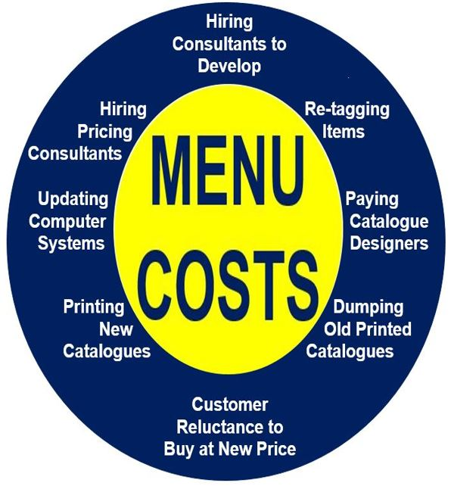
Consequences of Inflation - Business and Transaction costs
Summary
Menu Costs – businesses have to change prices.
Shoe leather costs – transport costs caused by people converting money and having to carry large amounts of cash.
Menu Costs – businesses must calculate new prices and then update the prices of their products on menus, websites, signs, billboards, brochures and other places which requires time and money
Shoe Leather Costs
  People will incur larger transportation costs to move money and withdraw money.
    Note: China is a largely cashless society and so this cost would be far less as people carry physical money less often.
  Because the value of money falls, individuals will spend time and effort converting cash into other things which are more stable eg. gold, jewellery, collectibles.
  Both of these things will cause people to expend time and energy on these activities which we semi-jokingly claim will wear out people’s shoes – thus the term ‘shoe leather costs’.
Consequences of Inflation Home

Slide 101
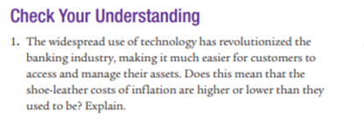
Module 14
Will be decreased, because people won’t have to spend as much effort, accessing their cash.
So shoe leather costs will be reduced.

Slide 102
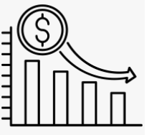
Consequences of Inflation - Redistribution of wealth
Summary
When there is inflation:
People with savings and fixed incomes will lose.
Borrowers will gain and lenders will lose.
Fixed Nominal Incomes worth less - Those on fixed incomes (eg. a pensioner on $100 a week) will see the value of their incomes fall if the price level rises.
Lower Value of Savings – holders of money will see the value of their savings decrease. This decreases the incentive to save which will in turn affect investment.
Borrowers gain and lenders lose – if the inflation is more than expected then borrowers will pay less money in real terms to pay back loans, and lenders will receive less in real terms. Eg. A borrower pays $50 per week, but the $50 is now worth less
Note: We will revisit the Fisher Effect in more depth in following units
Consequences of Inflation Home

Slide 103
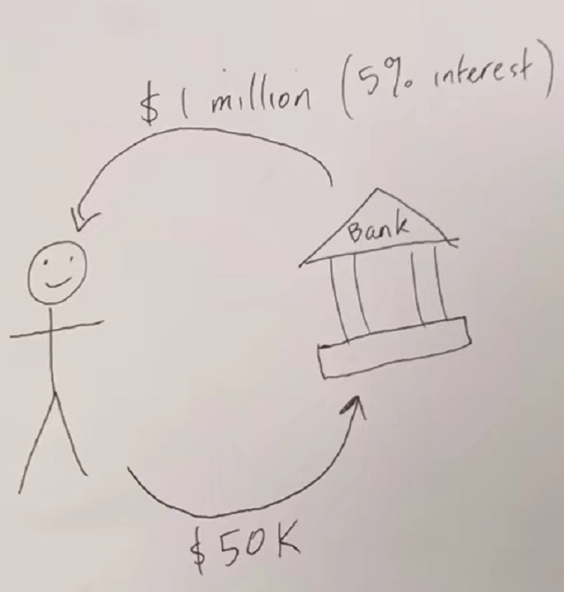


Inflation benefits borrowers
Borrowing and Interest
When an individual borrows money, they are usually expected to pay it back ‘with interest’.
Eg. You borrow $1000 and pay 5% interest. Therefore you will pay back $1050.
We know that interest is the cost of borrowing money / the reward for lending money – it is the extra money that must be paid back.
With inflation, the real value of all money decreases. Therefore the interest that you pay back will be worth less.
Before Inflation
50K = 1 car
After Inflation
50K = ¾ of a car
So you are getting an inflation discount in real terms!
Summary
With inflation, the interest paid back will have a lower real value. Borrowers will benefit from this.

Slide 104


Consequences of Inflation - Inefficient allocation of resources and Confusion
Money confusion and price illusion
Inflation can cause confusion or also cause people to act differently, simply because of the price level change, which leads to inefficiency and inefficient allocation of resources.
  Inflation confuses prices – businesses and individuals use prices to make decisions about what to buy and sell. Money is often used as a unit of account to measure real value but if prices are increasing it can be difficult to know if it is caused by changes in supply or demand or merely inflation. This leads to less efficient decision making and use of resources because it is hard to measure the value of something.
    Price illusion – people can’t tell the difference between inflation and real increases in price. They may also buy less than usual. Eg. “Clothes are so expensive these days. When I was young I would only pay $10 for a pair of jeans!”
  Reduced incentive to save & excessive consumption– individuals who see the price of products increasing may consume now for fear of further price increases, leading to a distortion of market preferences.
Consequences of Inflation Home

Slide 105


Unit of Account
No Confusion
Wow, this is a good salary! I will take the job. I can buy a house in 10 years with this salary.
We use money as a ‘unit of account’ to know the value of things in the economy.
  When the price level is stable, we can effectively use money as a unit of account.
  If the price level is not stable then it we cannot as effectively use money as a unit of account.
    Because the value of money will change and it will either be unpredictable or people who have not studied AP Macro will not know how to calculate.
Stable Price Level
I will pay you 20K per month.
Unstable Price Level (high inflation or deflation)
Confusion
Hmmm… I know this country has inflation, but I’m not sure how much. I heard it was 10% per year. But my friend thinks it’s as high as 15%. I am not sure if this is a good salary or not!
I don’t know how long it will take to afford a house with this salary. What if the inflation gets worse?
I will pay you 20K per month.
Summary
Stable price level – money can easily be a unit of account.
Unstable price level – money is not as easy to use as a unit of account.

Slide 106
Which of these best show the use of money as a unit of account?
  A consumer pays $500 for a new phone.
  A seller calculates the profits from a sale.
  A consumer compares the price of two phones that they are considering buying.
Best Answer: A consumer compares the price of two phones that they are considering buying.
  They are using the price to help measure how valuable the two phones are.

Slide 107
Consequences of Inflation Summary
Business and Transaction costs
  Menu Costs
  Shoe Leather Costs
Redistribution of wealth
  Fixed Income individuals lose (eg. pensioners)
  Borrowers gain at the expense of lenders
  Value of money savings falls
Inefficient allocation of resources
  Inflation distorts prices which makes business decision making more difficult
Inconvenience
Winners and
Losers
Confusion
Consequences of Inflation Home

Slide 108
Cost of Inflation Questions
What are three costs of inflation?
Menu costs, fixed income earners, borrowers gain at the expense of lenders, reduced value of savings, distortion of price/loss of unit of account
You have borrowed money from the bank for a mortgage and pay 3% interest a year. Inflation increases. Who benefits and who loses from the increased inflation?
You gain because the money you pay each year is now worth less.

Slide 109

Module 14
Answer: b
Answer: E
Answer: D
Answer: C
Answer: C

Slide 110

Module 14
A. Net loss
The net loss is shoe leather costs of many trips to the bank.
B. Net loss
The loss is changes to consumption habits in a negative way.

Slide 111

Module 14
c. Winners and losers
Hector gains because borrowers gain from inflation.
d. Net Loss
The cost is menu costs that the business must incur.

Slide 112
Why 2% Inflation Is the Fed’s Economic Bullseye | WSJ - YouTube

Slide 113
Real Interest and Nominal Interest

Slide 114
Consequences of Inflation Summary
Business and Transaction costs
  Menu Costs
  Shoe Leather Costs
Redistribution of wealth
  Fixed Income individuals lose (eg. pensioners)
  Borrowers gain at the expense of lenders
  Value of money savings falls
Inefficient allocation of resources
  Inflation distorts prices which makes business decision making more difficult
We will examine in more detail this idea by understanding the differences between nominal and real interest rates and expected vs unexpected inflation.
Consequences of Inflation Home

Slide 115
Which one is the best deal?
Summary
Knowing inflation can help us to calculate the real interest rate.
Country 1
Country 2
You put 100 dollars in the bank.
The bank pays you 10% interest.
The inflation rate is 15%
You put 100 dollars in the bank.
The bank pays you 5% interest.
The inflation rate is 3%
Logically we can see that country 2 is the best deal, because your money is growing faster than the prices.
We can see that the Real Interest Rate is the most important and not the Nominal Interest Rate. Knowing the inflation is important.

Slide 116

The Fisher Equation and Interest
Borrowing and Interest Review
When an individual borrows money, they are usually expected to pay it back ‘with interest’.
Eg. You borrow $1000 and pay 5% interest. Therefore you will pay back $1050.
Logically, because Inflation decreases the value of money, interest payments are worth less.
This relationship can be stated mathematically
  It was identified by the economist Robert Fisher and is therefore called the Fisher Equation.
Real Interest = Nominal Interest – Inflation
Or
Nominal Interest = Real Interest + Inflation
i = nominal interest
r = real interest
Π = inflation
Eg. The bank charges lends money and charges 5% interest for its the inflation rate is 2%. The real interest rate is 5-2=3%.
Summary
Nominal interest = the number cost of borrowing
Real interest = the true cost of borrowing
Real interest = nominal interest - inflation
Consequences of Inflation Home

Slide 117
What is the equation for real interest rates? (Note: Also called the Fisher Equation after the economist Robert Fisher.)
Real interest rate = Nominal Interest Rate – Inflation
Inflation decreases the value of money that borrowers have to pay back, even though the number they pay back is the same.

Slide 118
Using the Fisher Equation, which one is the best deal?
Country 1
Country 2
You put 100 dollars in the bank.
The bank pays you 10% interest.
The inflation rate is 15%
Real Interest (%) = Nominal Interest (%) – Inflation (%)
= 10% - 15% = -5%
You are losing 5% of your money every year!
You put 100 dollars in the bank.
The bank pays you 5% interest.
The inflation rate is 3%
Real Interest (%) = Nominal Interest (%) – Inflation (%)
= 5% - 3% = 2%
You are making 2% every year.
We can see that the Real Interest Rate is the most important and not the Nominal Interest Rate. Knowing the inflation is important.

Slide 119




Banks and Loans
Different Types of Loans
There are many different types of loans! Examples:
Business Loan – loan to businesses
Mortgage – loan for people to buy a house
Student loan – loan for people to pay for their education
How Banks Approach Inflation
When a bank lends, they try to consider the inflation level, using the Fisher Equation.
If inflation is 2% we need to charge more than 2% to make real interest!
Did You Know?
When you are saving money in the bank, you are the lender and the bank is the borrower!
The bank will not always be the lender.
Summary
Banks will always charge a nominal interest higher than inflation.
There are different types of loans.
Banks can be the borrower as well as lender.

Slide 120
You save money in the bank. The bank pays you 2% interest and inflation is 3%. What is the real interest rate?
RIR = NIR – Inflation = 2 – 3 = -1%
In this situation, who is the borrower and who is the lender?
You are the lender. The bank is the borrower. (Hint: The one who pays the interest is always the borrower)
What can we say about the money you have put in the bank?
It has actually lost value because the RIR is negative.

Slide 121



Winners and Losers
Unexpected/Unanticipated Deflation (Negative Inflation)
-> Lower Actual Inflation
-> Higher RIR (=NIR – Inflation)
Lenders win.
Borrowers lose.
Unexpected/Unanticipated Inflation
-> Higher Actual Inflation
-> Lower RIR (=NIR – Inflation)
Borrowers win.
Lenders lose.
No Unexpected Inflation/Deflation
-> Actual Inflation is the same.
-> RIR is the same.
If there is no unexpected inflation or deflation, then there is no winner or lower!
Summary
Unexpected inflation -> borrowers win
Unexpected deflation -> lenders win
No unexpected inflation/deflation -> no winners or losers

Slide 122




Example – Unexpected Inflation
BEFORE Unexpected Inflation
The bank expects 3% inflation, the bank sets NIR = 8%
  We often assume the nominal interest rate is part of a contract which cannot be changed.
RIR = 8% - 3% = 5%
Before:
Nominal interest = 8%
Real Interest = 8-3 = 5%
AFTER Unexpected Inflation
AFTER
Inflation unexpectedly increases to 5%
  RIR = 8% - 5% = 3%
Because the bank already set their nominal interest rate in a contract, they can’t change even though they want to.
After:
Nominal interest = 8%
Real Interest = 8- 5 = 3%
Winners and Losers
The borrower gains and the lender (bank) loses.
Summary
Banks often cannot change the NIR because it is agreed on beforehand.
Unexpected inflation will cause winners and losers.
Consequences of Inflation Home

Slide 123
How To Solve Questions With Expected and Actual Inflation
Expected Situation
RIR = NIR – Inflation
= 5% – 3% = 2%
In order to solve these questions it can be logical to calculate two situations;
  1. the expected situation
  2. the actual situation.
Eg. A bank pays 5% nominal interest and expected inflation is 3% where as actual inflation is 2%. Who gains and who loses?
So the Actual Real Interest is more than expected, therefore the lender gains and the borrow loses. (Lenders receive interest and borrowers pay the interest)
Actual Situation
RIR = NIR – Inflation
= 5% – 2% = 3%

Slide 124
If there is unexpected inflation, what happens to the real interest rate?
Decreases.
RIR = NIR – Inflation. If there is unexpected inflation, actual inflation is greater, therefore RIR is lower.
Does this benefit the borrower or lender?
Borrower. They want to pay a lower real interest rate.
If there is unexpected deflation, what happens to the real interest rate?
Increases.
RIR = NIR – Inflation. If there is unexpected deflation, actual inflation s lower, therefore RIR is higher.
Does this benefit the borrower or lender?
Lender. They want to receive a higher real interest.

Slide 125
Fixed vs Variable Nominal Interest
Fixed Nominal Interest
Most questions involve fixed nominal interest
  Fixed = does not change
Variable Nominal Interest
Variable interest is the opposite of fixed interest
  Variable = does change
  Variable interest is common in the real world but in our course often the questions focus more on fixed interest.
  Variable interest typically has no winners and losers.
    Eg. The variable interest will go up and down with inflation. So if we have unexpected inflation, the NIR will also go up, so the RIR will stay the same. Therefore no winners or losers.
      Eg. RIR = 5 – 2 = 3. With unexpected inflation to 3%, RIR = 6 – 3 = 3. The NIR went up so that RIR was unchanged.
Can have winners and losers
No winners and losers

Slide 126
The bank believes there will be 5% inflation this year, but the actual inflation is 7%. Who gains and who loses assuming we have fixed nominal interest rates?
Expected: RIR = NIR – 5%
Actual: RIR = NIR – 7%
Even without knowing the NIR, it is the same in both cases, therefore the Actual RIR < Expected RIR.
  Therefore the borrower wins and the lender loses
  (Borrower pays less real interest)
What about if there are variable nominal interest rates?
There would be no winners and losers.

Slide 127

Module 14
Real Interest = Nominal – Inflation, and the inflation is smaller than before so real interest is higher.
So the lenders will gain, and borrowers lose.
Consequences of Inflation Home

Slide 128

Module 14
A. Real Interest = Nominal – inflation = 5% - 5% = 0%
This is a great deal!
B. You gained because you didn’t have to pay anything to borrow money.
C. The bank lost.

Slide 129

Borrowers gain

Slide 130


Bonus: Expected vs Unexpected Inflation
In many different ways we make guesses about the future (eg. the weather, stocks, politics etc.)
We also make guesses about future inflation.
The inflation that we expect is called expected inflation or anticipated inflation.
The inflation that we did not expect is unexpected inflation or unanticipated inflation.
We can express the relation between these mathematically:
Just as we predict the weather, we try to predict inflation.
Actual Inflation = Expected Inflation + Unexpected Inflation

Slide 131
The bank believes there will be 5% inflation this year, but the actual inflation is 7%. What is unexpected inflation?
Actual inflation = Expected + unexpected inflation
Unexpected inflation = 7-5 = 2%
The bank believes there will be 5% inflation this year, but the actual inflation is 3%. What is unexpected inflation?
Actual = expected + unexpected
Unexpected inflation= -2%
Therefore there is 2% unexpected DEFLATION

Slide 132
Measuring Inflation

Slide 133


Methods of Measuring Inflation
How do we measure inflation in the economy?
There are many ways to do this, the two most prominent being the Consumer Price Index (CPI) and the GDP Deflator method.
Consumer Price Index (CPI)
GDP Deflator

Slide 134
What are the two main price indexes used to measure inflation?
The Consumer Price Index (CPI)
The GDP Deflator
  (even though the name does not contain index, it is still a price index)

Slide 135
Consumer Price Index (CPI)

Slide 136



Consumer Price Index (CPI)
Summary
The CPI includes things that households buy ONLY
The CPI is concerned with the goods and services that consumers/households typically buy.
What are some things that consumers usually buy? (Consumers are regular individuals who buy typical goods and services)
Things typically bought by consumers
Food
Clothes
Accommodation/housing
Cars
Computers
Phones
Education
Doctor/Dentist visits
Things not bought by consumers:
Jet planes, machine guns, concrete, trucks, industrial machines?
Consumers usually don’t buy these things so they’re not included in the CPI basket.

Slide 137
The CPI Market Basket
Imagine a huge basket of goods that has all the things we buy in a year! (From the previous slide)
These goods and services that a typical consumer buys in one year make up the Consumer Price Index Market basket – the CPI Market basket.
1 year
Consumer Price Index (CPI) basket = a big basket of goods and services that the average person buys in a year. (No rockets, trucks or big machines)

Slide 138

The Market Basket
Which do you spend more money on?
  Food or clothes?
  Laptops or cars?
  Movies or school fees?
On average, consumers spend more money on some things than other things. For example we often spend a lot of money on food and maybe only some money on watching movies. (See the pie graph above) If we take the average proportions for all consumers we can help to construct the correct market basket.
So when we calculate the CPI we need to account for how much we buy of something. This is the true ‘CPI basket’ or ‘market basket’.
Summary
The market basket (MB) shows the the fraction/percentage of total consumption on each item. This is important for the MB to be accurate.

Slide 139

Calculate the value of the market basket
MB₂₀₁₀ = (100 x 2) + (50 x 1.50) + (25 x 1)
= 200 + 75 + 25
= 300
Calculating the market basket value.
We use price X quantity for each of the goods in the market basket!

Slide 140

Using the Market Basket
To calculate the change in the price level, we compare the price of the same basket over different years.
  We must keep the goods and services in the basket the same over different years to have an accurate comparison.
If the value of the basket increases, we have inflation.
If the value of the basket decreases, we have deflation.
Year 1
Basket Price = $130
Year 2
Basket Price = $140
Year 3
Basket Price = $145
Summary
We use the price of an identical basket over different years to see the change in price level.
Basket price increases – inflation
Basket price decreases - deflation

Slide 141



Using the CPI Market Basket to calculate Inflation
Summary
We compare the price of the CPI market basket over time to find the inflation rate using the simple percentage change formula.
Now that we have the market basket, how do we use it to calculate inflation?
We simply compare the price of the same basket over multiple years.
By using a generic rate of change formula we can find the inflation rate as a percentage.
Rate of Change Formula:

Slide 142
2021 Basket Price = $4325
2022 Basket Price = $4721
If the market basket in 2021 is $4,325 and $4,721 in 2022. What is the inflation rate over this period?
=[(new-old) /old] x 100% = (4721-4325)/4325 x 100% = 9.16%

Slide 143

Example
The Base Year
It is very important to understand the concept of the base year.
The base year is the point from where we make the comparison.
The base year can be any year, it completely depends on your choice.
So if the market basket price has increased by 15% from the base year, then there was 15% inflation since that time.
However, if the base year is a long time ago, there may have been different levels of inflation and deflation at different points.
  MB₂₀₁₈ = $7,385
  MB₂₀₁₉ = $7,543
  MB₂₀₂₀ = $7,757
The base year is typically, but not always, the earliest year from our list.
Base year
Summary
The base year is any year that we choose.
We compare other years to the base year. It is our point of reference.

Slide 144
What is the purpose of the base year?
To compare other years to this year. In this case, we are comparing the price level of other years to the base year to find inflation.
Is the base year always the earliest year?
No, not necessarily, though it usually is.

Slide 145


Calculating the CPI Index
Summary
Market Basket – given in terms of money units.
CPI – no units, and base year always = 100
The CPI numbers are ‘nicer’ so we can more easily see inflation or deflation over the years.
The Market Basket is in dollars/RMB/Euros etc. but these numbers are often large and inconvenient.
We convert these numbers to a ‘nicer’ form, which is the CPI index.
Comparison of MB vs CPI.
It is much easier to compare 100, 102.1 and 105 than it is to compare 7385, 7543 and 7757!
We can clearly see that from 2018 prices, inflation is 2.1% in 2019 and this would be much harder with the MB values.
Market Basket | CPI
$7,385 | 100
$7,543 | 102.1
$7,757 | 105
To calculate the CPI we divide the market basket by the base year market basket and multiply by 100 for multiple years:
  CPI = CPI Basket / CPI Basket_{base year} x 100
The base year for the CPI is always 100. We choose 100 because it is an easy number to look at to measure inflation. We will see how it is easier to see inflation quickly.
Example
  2018 CPI = $7,385 / $7,385 x 100 = 100 – base year
  2019 CPI = $7,543 / $7,385 x 100 = 102.1
  2020 CPI = $7,757 / $7,385 x 100 = 105

Slide 146
Requires no calculation
Market Basket Values
MB₂₀₁₈ = $7,385
MB₂₀₁₉ = $7,543
MB₂₀₂₀ = $7,757
CPI Values
2018 CPI = 100
2019 CPI = 102.1
2020 CPI = 105
2.1% inflation since 2018.
5% inflation since 2018.
If we use the Market Basket or the CPI, the inflation rate will be the same.
But with the CPI it will be easier to read without any need for calculation.

Slide 147
What are the units of the market basket of the CPI?
Money units: RMB, Dollars, Pesos etc.
What are the units of the CPI?
No units, it is just an ‘index’ number.
What is the value of the CPI in the base year?
100

Slide 148

Interpreting the CPI Values
CPI > 100
  Inflation
  Price level has increased
CPI < 100
  Deflation
  Price level has decreased
Eg. CPI = 105
5% inflation in the economy from the base year
Eg. CPI = 90
10% deflation in the economy from the base year

Slide 149
CPI Summary
We convert the ‘messy’ price of the basket to the CPI which makes it easier to see the change over time.
Market Basket | CPI
$7,385 | 100
$7,543 | 102.1
$7,757 | 105
Year 1
Year 2
Year 3
Price = $730
Price = $880
Price = $950
The Consumer Price Index (CPI) measures the price of a basket of goods over time.
  The basket shows only goods that typical consumers/households buy.
    Eg. Exclude trucks and military equipment etc.
An increasing basket price shows inflation, a decreasing basket price shows deflation.
  CPI = CPI Basket / CPI Basket_{base year} x 100
Example
  2018 CPI = $7,385 / $7,385 x 100 = 100 – base year
  2019 CPI = $7,543 / $7,385 x 100 = 102.1
  2020 CPI = $7,757 / $7,385 x 100 = 105
CPI > 100
  Inflation
  Price level has increased
CPI < 100
  Deflation
  Price level has decreased

Slide 150


Module 15
Multiple Choice
1. D
2. C
3. D

Slide 151

Rate of change formula = (new – old) / old
Using the CPI (Ignore the GDP Deflator):
Inflation 2004 to 2005 = 195-188.9 / 188.9 = 3.4%
Inflation 2005 to 2006 = 201.6-195.3 / 195.3 = 3.2%

Slide 152

Inflation = [(207.3 – 201.6) / 201.6 ] x 100% = 2.8%

Slide 153

Equations Regarding Inflation So Far
  CPI = CPI Basket / CPI Basket_{base year} x 100
Fisher Equation (Explains real interest rate and inflation, named after economist Robert Fisher):
  Nominal Interest = Real Interest + Inflation
  OR Real interest = Nominal interest - inflation
  Eg. The bank charges 5% interest for its mortgages and the inflation rate is 2%. The real interest rate is 5-2=3%.
Real Wage Growth:
  If inflation increases by more than real wages, then real wage will decrease
i = nominal interest
r = real interest
Π = inflation
Actual Inflation = Expected Inflation + Unexpected Inflation

Slide 154
CPI Review Questions
What is the CPI Market Basket?
The CPI basket is a big basket of goods that the typical consumer buys in one year.
How do we calculate the value of the Market Basket?
For each good we multiple the price x the quantity and sum these together to get the ‘CPI Market Basket’.
What is the value of the CPI in the base year? Why do we do this?
CPI_{baseyear} = 100
The CPI is an easier way to compare the value of the basket, because the numbers are easier for humans to understand. Eg. CPI = 105 means 5% inflation without needing to calculate

Slide 155

Answer: Inflation

Slide 156

Random Inflation Questions
Inflation = new – old / old
= 150-120 / 120
= 30/120
=25%
Answer: B

Slide 157

B. 100
B. Falls because prices go up (200%) more than your wage. (100%)
Mathematically we can say:
Real Wage = Nominal wage x Pi_{base} / Pi_{current}
If Pi_{current} changes x 3 and Nominal wage increases only x 2, then real wage is only 2/3 of the original

Slide 158
Do 400Q 1-8 Exercises
Do 2.4 APQB Exercises

Slide 159


Slide 160
Answers
A.
MB₂₀₁₀= (100 x 2) + (50 x 1.50) + (25 x 1)
= 200 + 75 + 25
= 300
MB₂₀₁₅= (100 x 2.5) + (50 x 2.20) + (25 x 1.2)
= 250 + 110 + 30
= 390
B.
CPI₂₀₁₀= (300 / 300) x 100 = 100
CPI₂₀₁₅= (390 / 300) x 100 = 130
c) The inflation rate from 2010 to 2015 is 30% (which we can see easily from the change in CPI from 100 to 130).
Therefore, workers must have an increase in their wages by 30% to have the same standard of living (where they can buy the same amount of goods and services).

Slide 161

A. Base year CPI is always 100.
B. If prices double then new CPI is 200.
C. Nominal income increased by 100%.
D. Prices increase by 100% and Nominal Wages increase by 100%.
Therefore Real Wages are the same.

Slide 162

Problems with the CPI
Summary
The CPI can overstate or understate the impact of inflation.
Link
The CPI fails to take into consideration the changes in:
  The quality of goods and services over time.
    Eg. TVs, Cars, Computers are faster, more reliable and have more features compared to the past
  The typical household market basket can change over time and the CPI does not account for these changes
    New products – eg. Smartphones or even mobile phones didn’t exist 50 years ago and so it is hard to compare identical baskets
    Tastes – eg. people start buying more leisure goods compared to past years which also changes the basket
    Substituting goods for other goods. Eg. if the price of bread increases, people may buy more potatoes and so the price increase won’t affect consumers as much
Most commonly asked about.
Overstate inflation!
Why does this matter?
A good experiment should control for all variables except the one we want to measure – increase in price.
When other variables are unaccounted for, this can bring the results into doubt!
However, We still use CPI as the main method of calculating inflation even if it sometimes fails to tell the whole story.
Can overstate or understate inflation!
Can overstate or understate inflation!
Overstates inflation!

Slide 163




The Real Basket Changes over Time
2kg
3kg
2kg
1kg
CPI Basket - Constant
Real Basket – Always Changing!!!

Slide 164
What is the main reason that the CPI can sometimes overstate or understate the effect of inflation?
The CPI assume all goods in the basket are constant
BUT
In reality, the basket that people are really buying IS CHANGING because of quality, new goods, changes of tastes and subtitution

Slide 165
Example – CPI doesn’t measure increase of quality
Let’s say smart phones go up in price by 20%.
But the quality of the phones also goes up by 20%
What is the story told by the CPI and what is the story in reality?
Reality
“Price of robots is 20% higher.”
“So overall there is a real change in prices.”
Reality
“Price is 20% worse.”
“But the phones are also 20% better.”
“So overall there is no real change.”
CPI
“Price is 20% higher.”
“Overall we are worse off.”
The CPI is overstating inflation in this case. It claims inflation is worse than it really is.

Slide 166

But it would be the opposite if the quality of goods decreases!

Slide 167
Example – Basket contains more of a type of good because consumers have substituted towards this good
Let’s say people buy 2kg of apples and 2kg of oranges.
Then the prices of oranges goes up by 20%.
  People will naturally buy fewer oranges and more apples, substituting to the cheaper good.
What is the story told by the CPI and what is the story in reality?
2kg
CPI
“Price of oranges is 20% higher.”
“Overall we are worse off.”
Reality
“Price of oranges is 20% higher.”
“BUT we are buying less oranges than before because we substitute to apples.”
“So overall we only slightly worse off.”
3kg
1kg
2kg
The CPI is overstating inflation in this case. It is saying the situation is worse than it is.

Slide 168
Example – CPI doesn’t measure new goods
Let’s say people start buying AI robots for doing chores
Then the prices of these go up by 20%.
What is the story told by the CPI and what is the story in reality?
Reality
“Price of robots is 20% higher.”
“So overall we are worse off.”
CPI
“All the goods in the basket are the same.”
“Overall we are the same.”
The CPI is understating inflation in this case. It is saying the situation is better than it really is.

Slide 169
Example – Basket contains more of a type of good
Let’s say people start buying more meat than in previous years.
Then the prices of meat goes up by 20%.
What is the story told by the CPI and what is the story in reality?
CPI
“Price is 20% higher.”
“Overall we are worse off.”
Reality
“Price is 20% higher.”
“AND we are buying more meat than before.”
“So overall we are more significantly worse off.”
The CPI is understating inflation in this case. It is saying the situation is better than it is.

Slide 170
Will the CPI

Slide 171


A. The basket doesn’t contain enough cars therefore it will understate the value of the basket and understate inflation.
B. The quality of internet is higher because of broadband. This increase in quality is not measured in the basket and so will overstate the cost of the basket, and overstate inflation.

Slide 172

Random Inflation Questions
Answer: A
Overstates because of things like:
Not accounting for increase in quality of goods (eg. iPhones are much better than 10 years ago)
Not accounting for substitution of more expensive goods for cheaper goods
These are most commonly asked about

Slide 173
Methods of Measuring Inflation
Price Indexes / Price Indices
Consumer Price Index (CPI)
GDP Deflator

Slide 174
Nominal vs Real GDP
Before we cover the GDP Deflator, we need to cover Nominal vs Real GDP

Slide 175


Nominal vs Real GDP
Nominal vs Real
Recall that nominal values are simply a number and real values show the true values.
Nominal GDP
Nominal GDP simply refers to the monetary amount of GDP.
Does not account for inflation.
Nominal GDP could increase if:
  More G&S or more valuable G&S produced in the economy
  A higher price level.
    increase of prices would cause the nominal GDP to increase, even if real output is the same.
Real GDP
Growth in the real GDP shows an increase in the true production in the economy – the real output.
Accounts for inflation
Real GDP could increase only if:
  More or more valuable G&S produced in the economy.
Summary
Nominal GDP – measures the monetary value of output and so is affected by price level change/inflation
Real GDP –measures the real output of the economy and so is not affected by price level/inflation – it is adjusted for inflation

Slide 176
Which accounts for inflation and which does not?
RGDP accounts for inflation
NGDP does not account for inflation.
What can increase Nominal GDP?
An increase in price level OR
A true increase in the quantity/quality of what is produced.
What can increase Real GDP?
A true increase in the quantity/quality of what is produced only.

Slide 177


Nominal vs Real GDP Calculation
Summary
Nominal GDP – current prices, current quantity
Real GDP – base year prices, current quantity
To find Nominal GDP and Real GDP we use the same price x quantity method.
Real GDP – use base year prices and quantities from that year.
Nominal GDP – the prices from that year and quantities from that year.
Calculating GDP with Price and Quantity
NGDP = Prices_{current} x Quantity_{current}
RGDP = Prices_{base} x Quantity_{current}
Nominal GDP_{year1} = Price_{GoodA} x Quantity_{GoodA} ₊ Price_{GoodB} x Quantity_{GoodB}
= $1000 x 20 + $1 x 5000 = $25,000
Nominal GDP_{year2} = Price_{GoodA} x Quantity_{GoodA} ₊ Price_{GoodB} x Quantity_{GoodB}
= $1500 x 20 + $1.20 x 5000 = $36,000
Real GDP_{year1} = Price_{GoodA} x Quantity_{GoodA} ₊ Price_{GoodB} x Quantity_{GoodB}
= $1000 x 20 + $1 x 5000 = $25,000
Real GDP_{year1} = Price_{GoodA,} _{baseyear} x Quantity_{GoodA} ₊ Price_{GoodB} x Quantity_{GoodB}
= $1000 x 20 + $1 x 5000 = $25,000
Note: In the base year, Nominal and Real GDP are equal!

Slide 178
What is the difference between nominal GDP and real GDP in terms of prices?
Nominal GDP uses the most current prices.
Real GDP always uses base year prices ie. ‘old prices’, which means it controls for inflation.
What does the phrase “GDP in current prices” indicate – Nominal or Real GDP?
Nominal GDP.
In the base year, what is the difference between nominal and real GDP?
They are equal.

Slide 179
Nominal GDP
New prices x new quantity
Good | Year 1 Price | Year 1 Quantity | Year 2 Price | Year 2 Quantity
Good A | 20 | 100 | 25 | 110
Good B | 30 | 80 | 35 | 90
Good C | 40 | 60 | 45 | 70
Real GDP
Base year prices x new quantity
Note:
In the base year, NGDP = RGDP
RGDP:
Year 1: RGDP = NGDP = (20 x 100) + (30 x 80) + (40 x 60)
Year 2 = (20 x 110) + (30 x 90) + (40 x 70)
NGDP:
Year 1: RGDP = NGDP = (20 x 100) + (30 x 80) + (40 x 60)
Year 2 = (25 x 110) + (35 x 90) + (45 x 70)

Slide 180


2009
Nominal GDP = 1 million x 0.4 + 800K x 0.6 = 880
Real GDP = same
2010
Nominal GDP = 900K x 0.5 + 840K x 0.51 = 878.4
Real GDP = 900K x 0.4 + 840K x 0.6 = 360+ 504
= 864
If we use the old prices from the first year/base year, then we will be able to see the growth in quantity, which is the real change.
b) Nominal GDP does not account for price changes. Therefore when there is inflation it will overstate GDP growth even if there is no real growth. (If there is deflation it will understate GDP growth.)
Nominal GDP
New prices, new quantity
Real GDP
Old prices, new quantity

Slide 181

Answer: D

Slide 182


Answer: b) Real GDP

Slide 183


Year 1
Real GDP = 3000 x 0.2 + 2000 x 0.4
= 1400
Year 2
Real GDP = 4000 x 0.2 + 3000 x 0.4
= 2000
Answer: C

Slide 184
Complete Remaining Module 11 Questions
Gross Domestic Product (GDP)
Real vs Nominal GDP

Slide 185
Methods of Measuring Inflation
Price Indexes / Price Indices
Consumer Price Index (CPI)
GDP Deflator

Slide 186
GDP Deflator

Slide 187



GDP Deflator
GDP Deflator = what is produced in the economy.
CPI = what is bought in the economy by consumers.
The GDP Deflator is another method of calculating inflation.
It also creates a huge basket of goods and services, but it has one key difference with the CPI.
  It is based on what is everything produced in the economy rather than what is purchased by consumers.
Mathematically, we will see that the GDP deflator takes the ratio of the Nominal GDP & Real GDP by dividing the values. This allows us to see the level of inflation.
Summary
GDP deflator does the same thing as CPI.
It measures everything produced in the economy!
(CPI measures what is bought in the economy)

Slide 188
True or False?
  The CPI is a price index used to measure inflation.
  True
  The GDP Deflator is a price index used to measure inflation.
  True. Even though it does not have ‘price index’ in its name.
  The CPI includes all G&S produced in the economy and the GDP deflator includes only things consumed by households.
  False. The GDP deflator incudes all things produced. CPI is for household consumption goods and services.

Slide 189

Calculating the GDP Deflator
We calculate the GDP deflator using the following formula.
Example
If Nominal GDP = $15 trillion and Real GDP = $10 trillion
GDP Deflator = 15 / 10 x 100 = 150

Slide 190
Example: Find the GDP Deflator
An economy produces 5 million cars in 2020 and 2021. The price of the cars in 2020 are $10 and $20 in 2021.
Assume that the base year is 2020.
2020
Nominal GDP = 5 million x $10 = $50 million
Real GDP = 5 million x $10 = $50 million
GDP Deflator₂₀₂₀= Nominal GDP / Real GDP x 100
= 50 million / 50 million x 100
= 100
Note: The Nominal GDP and Real GDP is always the same for the base year!
The GDP deflator is always 100 in the base year.
2021
Nominal GDP = 5 million x $20 = $100 million
Real GDP = 5 million x $10 = $50 million
GDP Deflator₂₀₂₁= Nominal GDP/Real GDP
= (100 million / 50 million) x 100
= 200

Slide 191
GDP Deflator Calculations and Interpretation
GDP Deflator > 100
  Inflation
  Price level has increased
GDP Deflator = 100
  No change in price level
GDP Deflator < 100
  Deflation
  Price level has decreased
Eg. GDP Deflator = 105
5% inflation in the economy from the base year
Summary
The GDP deflator is treated the same as the CPI.
We set base year value of 100.
Then it is easy to look at inflation/deflation in other years.

Slide 192
Interpreting the CPI and GDP Deflator Values
> 100
  Inflation
  Price level has increased
Increase and Decrease
↑Index = inflation
Eg. Price Index₂₀₂₀ = 132, Price Index₂₀₂₁ = 140
Inflation = (140 – 132) / 132 x 100 = 6.1%
= 100
  Price level hasn’t changed
↓Index = deflation
Eg. Price Index₂₀₂₁ = 115, Price Index₂₀₂₂ = 107
Inflation = (107-115)/115x100 = -6.95% = 6.95% deflation
< 100
  Deflation
  Price level has decreased
GDP Deflator and CPI - they function the same way!
Eg. CPI or GDP Deflator = 105
5% inflation in the economy from the base year
Eg. CPI or GDP Deflator = 90
10% deflation in the economy from the base year
Summary
The CPI and GDP deflator numbers are treated the same.
  Base year = 100, >100 = inflation, <100 = deflation
↑Index = inflation, ↓Index = deflation

Slide 193
Methods of Measuring Inflation Comparison
Summary
CPI and GDP Deflator are both price indices used to measure inflation and so are used the same way.
Base year = 100.
CPI – basket of consumer goods.
GDP Deflator – basket of all goods produced ie. GDP.
Consumer Price Index (CPI)
Based on goods and services that consumers purchase
Measures imports (because the consumer basket will include imports (eg. iPhones, French wine, German Cars, American Movies)
The base year for the CPI is always 100
CPI = CPI Basket / CPI Basket_{base year} x 100
GDP Deflator
Compares nominal and real GDP
Based on goods and services produced in the economy
Doesn’t measure imports (only things produced as part of GDP)
The base year GDP deflator is also always 100.
GDP Deflator = NGDP/ RGDP x 100
Note: While CPI is most widely cited, both are used as measures of inflation and have historically returned similar values. (See next slide)

Slide 194

GDP Deflator vs CPI
While they often provide different results, we can see that GDP Deflator measures and CPI historically give similar values for inflation.

Slide 195
What is the value of the GDP deflator in the base year?
100
What is the value of the CPI in the base year?
100
What is the purpose of the GDP deflator?
To measure inflation.
What is the purpose of the CPI?
To measure inflation.
We can describe the CPI and GDP deflator, both as ______________.
Price indexes, sometimes referred to as PI.

Slide 196
How to know when a question is CPI or GDP Deflator?
When calculating inflation it doesn’t matter if it is the CPI or GDP deflator because both are just Price Indexes (PI) used to measure inflation.
  Therefore the Inflation is equal to (PI_{new} – PI_{old}) / PI_{old} x 100%
Summary
Because the CPI and GDP Deflator function the same way, it doesn’t matter which we use. However certain words can give clues to which is being referred to.
CPI Questions:
  Market basket
  Consumer basket
Usually when it mentions the word basket we can assume CPI.
GDP Deflator Questions:
  Nominal and Real GDP
Either CPI or GDP Questions.
List of prices and quantities of goods
  It could mean what is produced (GDP Deflator) or what is consumed by consumers (CPI)

Slide 197

Is this question CPI or GDP Deflator?
CPI because ‘basket’ usually means CPI.
(GDP usually means it’s the GDP Deflator.)
In this course, will the numbers be different if it is GDP deflator or CPI? Bonus: What about in real life?
No, they will be the same.
Bonus: In the real world the numbers would be similar but different.

Slide 198


Price Indexes Summary
Problems with the CPI
The CPI fails to take into consideration the changes in:
  The quality of goods and services over time.
    Eg. TVs, Cars, Computers are faster, more reliable and have more features compared to the past
  The typical household market basket can change over time
    New products – eg. Smartphones or even mobile phones didn’t exist 50 years ago and so it is hard to compare identical baskets
    Tastes – eg. people start buying more leisure goods compared to past years which also changes the basket
    Substituting goods for other goods. Eg. if the price of bread increases, people may buy more potatoes and so the price increase won’t affect consumers as much
Overstate inflation!
Consumer Price Index (CPI)
Takes a large basket of goods
Based on goods and services that consumers purchase
Measures imports (because the consumer basket will include imports (eg. iPhones, French wine, German Cars, American Movies)
The base year for the CPI is always 100
  CPI = CPI Basket / CPI Basket_{base year} x 100
GDP Deflator
Compares nominal and real GDP
  NGDP – current prices
  RGDP – old/base prices
Based on goods and services produced in the economy
Doesn’t measure imports (only things produced as part of GDP)
The base year GDP deflator is also always 100.
Overstates or understates inflation!
Overstates or understates inflation!
Overstates inflation!
Note: Some of these issues such as quality of goods would also apply to the GDP Deflator.
Price Index > 100
  Inflation
  Price level has increased
Price Index < 100
  Deflation
  Price level has decreased

Slide 199
Revision Inflation Questions – CPI, GDP Deflator

Slide 200

GDP Deflator
2004-2005
  [(100 – 96.8)/96.8 ] x 100
  = 3.3%
2005-2006
  [(103 – 100)/100 ] x 100
  = 3.0%
CPI
2004-2005
  [(195.3 – 188.9)/188.9 ] x 100
  = 3.38%
2005-2006
  [(201.6 – 195.3)/195.3 ] x 100
  = 3.22%

Slide 201

GDP Deflator Questions
A) GDP Deflator = Nominal GDP/Real GDP x 100
GDP Deflator₂₀₀₂= 10469.6 / 10048.8 x 100 = 104
GDP Deflator₂₀₀₃= 10960.8 / 10301 x 100 = 106
GDP Deflator₂₀₀₄= 11685.9 / 10675.8 x 100 =
GDP Deflator₂₀₀₅= 12433.9 / 11003.4 x 100 =
GDP Deflator₂₀₀₆= 13194.7 / 11319.4 x 100 =

Slide 202
GDP Deflator Questions
Inflation = (Price Index_{new}-Price Index_{old})/Price Index_{old}
Inflation₂₀₀₃= (106.4
– 104.2)/ 104.2
= 2.1%
Inflation₂₀₀₄= (109.5 – 106.4)/ 106.4
= 2.914%
Inflation₂₀₀₅= (113– 109.5)/ 109.5
= 3.2%
Inflation₂₀₀₆= (116.6
– 113)/ 113
= 3.19%

Slide 203

GDP Deflator
Year 1
Nominal GDP = Real GDP =
2x2 + 1x4 = 8
GDP Deflator = 8/8 x 100 =100
Year 2
Nominal GDP = 3x2 + 2x 4 = 14
Real GDP =
2x2 + 1x4 = 8
GDP Deflator = 14/8 x 100 = 175
Quicker method:
The price of good x increased by 50%.
The price of good y increased by 100%.
Therefore the CPI will be between 50 and 100% larger than the base (100)
So 175.

Slide 204

Answer: C

Slide 205

MB₁₉₉₃ = 5 x 6 + 2 x 7 + 3 x 12
= 30 + 14 + 36 = 80
MB₁₉₉₄ = 5 x 5 + 2 x 9 + 3 x 19
= 25 + 18 + 57 = 100
Change = (100 – 80) / 80 = 20/80 = 25%
Answer: E

Slide 206

Price increases are not as bad for consumers because they can substitute for cheaper goods (though this is not always possible eg. Gas prices).
This causes the CPI to be overstated. Therefore Answer: A

Slide 207
Calculating RGDP

Slide 208
Formula for Real GDP – Rearranging GDP Deflator
In some questions we will be asked to find the Real GDP.
In these cases, we can rearrange the GDP deflator equation to solve for the unknown value.
Example:
GDP Deflator = 110, Nominal GDP = 3.4 billion, Real GDP = ?
We know the GDP deflator = Nominal GDP / Real GDP x 100
Rearranging, Real GDP = Nominal GDP / GDP Deflator x 100
Therefore Real GDP = 3.4 billion / 110 x 100 = 3.09 billion
Summary
We can use the formula for the GDP Deflator to find real GDP.
RGDP = NGDP/GDP Deflator x 100

Slide 209
What is one way that we can calculate RGDP if we have the GDP Deflator?
We can rearrange the GDP Deflator equation.
GDP deflator = Nominal GDP / Real GDP x 100
Therefore, Real GDP = Nominal GDP / GDP Deflator x 100

Slide 210

Random inflation questions
6.
Answer:
GDP Deflator = Nominal / Real GDP x 100
= 5000 / 4000 x 100 = 125
7.
Answer: B
Real GDP = Nominal / GDP Deflator x 100
= 6000 / 200 x 100 = 3000

Slide 211


General Formula for RGDP
Summary
The general formula for RGDP
= NGDP x PI/Pi_{base}
We have the formula for RGDP using the GDP deflator:
But we can also use a formula that lets us use both the CPI and GDP deflator (the two price indexes):
Real GDP = Nominal GDP / GDP Deflator x 100
Earlier year
“With inflation, we are trying to make real GDP smaller than nominal GDP.”
Therefore we should put the smaller value which will usually be the Price Index_{base} on top of the fraction as the numerator.
Earlier year
We are actually taking the ratios of RGDP/NGDP and Price Indexes… they must be equal and then we rearrange!

Slide 212
What is the general formula for finding RGDP using price indexes? Bonus: How do we find this equation?
RGDP = NGDP x PI_{earlier} / Pi_{current}
We can get this by considering the ratio of indexes to GDP.
  The ratio of NGDP to RGDP = the ratio of PI_{current} to PI_{base/earlier year}

Slide 213

Earlier year
Consider the following info:
Calculate the real GDP in 2013 and 2014.
Real GDP in 2013: $12bn x (100 / 100) = $12bn
Real GDP in 2014: $15bn x (100 / 107) = $14.02bn

Slide 214

RGDP = NGDP x PI_{base} / Pi_{current}
= 2.4 billion x 111 / 107
= 2.47 billion
Note: we can’t use the GDP Deflator version of this equation because the earlier year index is not 100.

Slide 215

A. Country A = (4000 – 2000) / 2000 x 100% = 100%
Country B = (6000 – 2000) / 2000 x 100% = 200%
B. Country A – stayed the same
Country B – doubled (100 to 200)
C. Real GDP_{CountryA} = Nominal GDP x (Price Level_{baseyear}/ Price Level_{new}) = 4000 x (100/100) = 4000
Real GDP_{CountryB} = Nominal GDP x (Price Level_{baseyear}/ Price Level_{new}) = 6000 x (100/200) = 3000

Slide 216
D. Country A = (4000 – 2000) / 2000 x 100% = 100%
Country B = (3000 – 2000) / 2000 x 100% = 50%
E. Country A:
  Real GDP per capita₂₀₀₅ = 2000 / 10 people = $200
  Real GDP per capita₂₀₁₀ = 4000 / 20 people = $200
E. Country B:
  Real GDP per capita₂₀₀₅ = 2000 / 10 people = $200
  Real GDP per capita₂₀₁₀ = 3000 / 15 people = $200
Could skip to part c

Slide 217
RGDP Summary
RGDP shows GDP without the effects of inflation.
  RGDP < NGDP when we have inflation
  RGDP > NGDP when we have deflation
  RGDP = NGDP in the base year and when we have neither inflation/deflation
Calculating RGDP using Price Indexes/Indices
General Formula
RGDP = NGDP x Pi_{base/earlier} / PI_{current}
Rearranging GDP Deflator Equation
RGDP = NGDP / GDP Deflator x 100
Calculating GDP with Price and Quantity
NGDP = Prices_{current} x Quantity_{current}
RGDP = Prices_{base} x Quantity_{current}

Slide 218
What can be said about RGDP and NGDP in a year if there has been inflation?
RGDP < NGDP
Real GDP = Nominal GDP x PI_{base} / Pi_{current}
  PI_{base} / Pi_{current} < 1
What can be said about RGDP and NGDP in a given base year?
They are equal.

Slide 219
Summary of Real and Nominal Equations
7.40 MRU video
Summary
We have now established three different equations regarding Real and Nominal values and inflation.
We now know that changes in the price level/ inflation affect the real GDP. This is given by the formula:
Real GDP = Nominal GDP x Pi_{base/earlier} / PI_{current}
We can apply this same equation to Real Wages as well:
Bonus: Real Wages = Nominal Wages x PI_{base} / PI_{current}
Note: %∆Real Wage = %∆Nominal Wage – Inflation, is not completely correct but for small values it gives a close answer and is often the method used in even official solutions.
A somewhat related, but mathematically different formula is the one for real interest.
Real Interest Rate = Nominal Interest Rate - Inflation

Slide 220
If nominal wages increase by 5% but there has been 7% inflation in that year, what change, if any, was there in the real wage? Bonus: Calculate the size of the change.
We can tell that real wages decreased because inflation > nominal wage growth.
Bonus:
  Real Wages = Nominal Wages x PI_{base} / PI_{current}
    PI_{base} is 100
    PI_{current} increases by 7% ie. 107
    N = your original nominal wage/real wage
    Nominal wage_{current} has increased 5% therefore = 1.05 x N
    Therefore Real Wage = 1.05 x N x 100 / 107 = 0.981 x N = 98.1% x original = 1.9% decrease
  Real wages shrank by 1.9%

Slide 221

Fisher Equation:
Real interest = nominal interest – inflation
Because inflation will reduce the real amount that people have to pay back
Answer: E

Slide 222


Equations Regarding Inflation
Calculating RGDP using Price Indexes/Indices
General Formula
Rearranging GDP Deflator Equation
X 100
Calculating GDP with Price and Quantity
NGDP = Prices_{current} x Quantity_{current}
RGDP = Prices_{base} x Quantity_{current}
Fisher Equation (Explains real interest rate and inflation, named after economist Robert Fisher):
  Nominal Interest = Real Interest + Inflation
  Eg. The bank charges 5% interest for its mortgages and the inflation rate is 2%. The real interest rate is 5-2=3%.
Real Wage:
Our real wage increases if our nominal wage increases faster than inflation.
Real Wages = Nominal Wages x PI_{base} / PI_{current}
  Note: As an approximation one can use: %△ Real Wages = %△ Nominal Wages – Inflation, but this is only an approximation
  Eg. Your boss gives you a raise of 5% from last year and inflation is 3%. Your real wages have increased by 5-3=2% approximately.
i = nominal interest
r = real interest
Π = inflation
Actual Inflation = Expected Inflation + Unexpected Inflation
(Unexpected Inflation – benefits borrowers, Unexpected deflation – benefits lenders)

Slide 223
Key Skills So Far
Calculate the price indices.
  Eg. What is the GDP Deflator/CPI for 2005 compared to 2000?
Calculate the inflation rate.
  Eg. Given the CPIs in the following years, what is the inflation for each year?
Calculate if real wages have increased or not.
  Eg. Inflation = x, Nominal wage increase = y, what is the change in real wage?
  We want inflation to be less than the change in nominal wage
Be able to calculate real GDP from indices and nominal GDP.
  Eg. The GDP deflator is x, the nominal inflation is y, what is real GDP?

Slide 224

Equations Regarding Inflation
Calculating RGDP using Price Indexes/Indices
Ratios of GDP and Indexes
General Formula for RGDP
RGDP by Rearranging GDP Deflator
X 100
Calculating GDP with Price and Quantity
NGDP = Prices_{current} x Quantity_{current}
RGDP = Prices_{base} x Quantity_{current}
Fisher Equation (Explains real interest rate and inflation, named after economist Robert Fisher):
  Nominal Interest = Real Interest + Inflation
  Eg. The bank charges 5% interest for its mortgages and the inflation rate is 2%. The real interest rate is 5-2=3%.
Real Wage:
Our real wage increases if our nominal wage increases faster than inflation.
Real Wages = Nominal Wages x PI_{base} / PI_{current}
  Note: As an approximation one can use: %△ Real Wages = %△ Nominal Wages – Inflation, but this is only an approximation
  Eg. Your boss gives you a raise of 5% from last year and inflation is 3%. Your real wages have increased by 5-3=2% approximately.
i = nominal interest
r = real interest
Π = inflation
Actual Inflation = Expected Inflation + Unexpected Inflation
(Unexpected Inflation – benefits borrowers, Unexpected deflation – benefits lenders)

Slide 225
3 Crucial Economic Indicators
The three biggest economic indicators used in Macroeconomics are:
  Gross Domestic Product (how big is the economy)
  Unemployment (how many people have jobs)
  Inflation (how stable are the prices of goods and services)
Economic Indicators
Gross Domestic Product (GDP)
Unemployment
Inflation
Unit 2
3 Economic Indicators

Slide 226
Goals of Government
Summary
The government looks at the three main indicators but has different objectives for each.
Governments try to manage the health of the economy and the three big indicators we have covered in Unit 2 are central to their decision making.
Generally speaking all governments want:
GDP
Government wants this to be:
high
Unemployment
Government wants this to be:
Low
Inflation
Government wants this to be:
Low and stable

Slide 227
Most governments around the world want to __________ GDP, ____________ unemployment and have ________ price levels.
High GDP
Low Unemployment
Stable

Slide 228
The Business Cycle – Revision

Slide 229


Business Cycle
Potential output is the ‘good, healthy level’ of the economy.
This naturally occurs for a variety of reasons, most importantly levels of debt through the economy
Note: Real Output is the same as Real GDP!
Note: Because technology and productivity is generally increasing (eg. better machines, faster computers, faster planes and trains), GDP usually increases over time, so the trend growth or potential output is upward sloping.
Trend line

Slide 230
  Contraction and Expansion
Summary
Recession – 6 months of negative GDP growth
Depression – a bad recession
Expansion – increase in GDP
Key term:
Recession: two or more quarters (6 months) of negative economic growth (fall in GDP).
Depression – has no technical meaning, but is a severe recession.
Key term:
Expansion: Economic activity increases and will finish by reaching the highest point called a peak.
If the periods in red last for more than 6 months, then it is considered a recession.
↓ Jobs
↑ Unemployment
↑Jobs
↓Unemployment

Slide 231
What is the definition of a recession?
Negative economic growth for more than 6 months.
What is the highest point of the business cycle?
Peak
What is the lowest point of the business cycle?
Trough
Economic expansion has what effect on unemployment?
Increased GDP requires more workers, increasing jobs, decreasing unemployment.

Slide 232
The Business Cycle and Output Gaps

Slide 233

Output Gaps
Potential output represents the output when the economy is at it’s ‘happy level’ and is a theoretical level.
Actual output is the level of production we see in the real world which often is different from the potential output.
We call the difference between Actual Output and Potential Output an output gap.
positive
negative
Note: can also be called a recessionary gap.
The difference between Actual and Potential output is called an output gap!
The economy is therefore in three states:
  Potential Output (happy level where Actual Output = Potential output)
  Positive Output Gap (producing at a higher but not sustainable level)
  Negative Output Gap (the economy is underperforming)
Output gap = Actual Output – Potential Output
Summary
The economy can be in a positive output gap, negative output gap or at potential output.

Slide 234

What is the size of the output gap of an economy with potential output of 15 trillion and actual output of 13 trillion. What kind of output gap is this?
Output gap = Actual – Potential = 13-15 = -2 trillion
This would be a negative output gap.
Label the points A, B and C as output gaps.
A – Positive Output Gap
B – Potential Output (no output gap)
C – Negative Output Gap

Slide 235
Business Cycles – Relation to Indicators
We can show how the business cycle informs us about the three big indicators – GDP, Unemployment and Inflation.
Inflation
Unemployment
GDP
Summary
The business cycle can show the relationship between the three big macro indicators.

Slide 236




GDP
Expansion – GDP increases
Contraction – GDP Decreases
Actual Output > Potential Output
Positive Output Gap:
Actual Output > Potential Output
Actual Output = Potential Output
Actual Output = Potential Output
Actual Output < Potential Output
Negative Output Gap:
Actual Output < Potential Output

Slide 237


Unemployment
The Natural Rate of Unemployment, NRU, occurs when Actual Output = Potential Output
Expansion – unemployment decreases
Contraction – unemployment increases
UR_{actual} < NRU
Positive Output Gap:
Actual UR < NRU
(more jobs = lower unemployment)
NRU
NRU
UR_{actual} > NRU
Negative Output Gap:
Actual UR > NRU
(few jobs = higher unemployment)

Slide 238




Inflation / Price Level
Summary
Positive Output Gap:
Higher demand -> Higher price level
Negative Output Gap:
Lower demand -> Lower price level
Expansion – people are consuming more goods which tends to increase the price level ie. inflation
Contraction – people are buying less goods which tends decrease the price level (deflation or lower inflation)
Higher price level
Positive Output Gap:
Higher Price Level
normal
Normal price level
Lower price level
Negative Output Gap:
Lower Price Level
Note: We will go into more depth about the causes of inflation in the following units.

Slide 239

Answer: B

Slide 240
An economy has cyclical unemployment that is NEGATIVE. Is this a positive output gap, negative output gap or at potential output?
Positive output gap ie. Point A

Slide 241
An economy has lower price level than usual. Is this most likely to be a positive output gap, negative output gap or at potential output?
Negative output gap ie. Point C

Slide 242
An economy is producing at a long term, sustainable level. Is this most likely to be a positive output gap, negative output gap or at potential output?
Output = Potential Output ie. Point B.

Slide 243
When there is a positive output gap, explain each of the following:
  Actual Output vs Potential Output
    Actual Output > Potential Output
  Actual Rate of Unemployment vs NRU
    Actual UR < NRU
  Price Level
    Higher (inflation)
When there is a negative output gap, explain each of the following:
  Actual Output vs Potential Output
    Actual Output < Potential Output
  Actual Rate of Unemployment vs NRU
    Actual UR > NRU
  Price Level
    Lower (deflation)

Slide 244
Unit 2 Revision
We have completed the Unit 2 Content for the course!

Slide 245
Coverage For Quiz 6
Inflation:
What is inflation? Deflation? Disinflation? Hyperinflation?
What are the costs of inflation?
Real vs Nominal Wage
Real vs Nominal Interest
Price Indices:
Price Indices – Consumer Price Index (CPI) and GDP Deflator
How to calculate the CPI
How to calculate the GDP deflator
How to calculate the inflation rate
Real GDP vs Nominal GDP:
How to calculate Real GDP from quantity and prices
How to calculate Real GDP from Nominal GDP and Price Indices
Business Cycle
Output Gaps
  Connection to Unemployment and Inflation

Slide 246
Practice Inflation Questions

Slide 247

AP Progress Check Questions
Answer: A
CPI increased by 10%

Slide 248

Jan’s real wage at the end of this year is $10 an hour because the base year equals 100.
Jan’s real wage is $250 per hour at the end of the year due to inflation.
Jan’s real wage is 25% higher because the CPI increased from 100 to 125.
Jan’s real wages are equal to the nominal wages.
Jan’s real wage is 8 per hour at the end of the year.
Answer: E
Real Wage = Nominal Wage x PI_{base} / Pi_{current}
= 10 x 100/125 = 8

Slide 249

Answer:
B. The price level increases but at a slowing rate.

Slide 250

Approach 1:
Real interest = nominal interest – inflation
Let’s say inflation = x
Before: RIR = 3 – x
After: RIR = 3 – (x – 5) = 8-x
8-x > 3-x
Therefore RIR has increased! So the banks must pay Myron a higher RIR
Approach 2:
Prices have fallen by 5% = unexpected deflation
Therefore lenders benefit and borrowers lose.
In this case Myron is lending to the bank so Myron gains and bank loses.
Answer: C

Slide 251

Actual Inflation = Expected Inflation + Unexpected Inflation
Actual > Expected
Eg. 5 = 3 + 2, Therefore unexpected inflation
This benefits borrowers and harms lenders.
Answer: C
Note: Variable interest rate loans mean that the Nominal Interest Rate will adjust automatically and keep RIR constant. So no one gains or loses.
Fixed interest rates will have winners and losers if there is unexpected inflation/deflation.

Slide 252

Answer: E
The workers are receiving 3% more salary but will have to pay 4% more for G&S so they lose. Therefore employers gain.

Slide 253

Answer: B

Slide 254

Answer: A
Real GDP = Nominal / (Nominal / Real)
= Nominal / GDP Deflator

Slide 255
Answer: B

Slide 256

Answer: D
The natural rate of unemployment = ‘full rate of employment’
This DOES NOT mean 0% unemployment/ 100% employment!

